Slide 1
Adjustments - the Why, What and How
SolÈNe ANGLARET
21 September 2023

Slide 2
Solène Anglaret (she/her)
Born in Paris and raised in Normandy, France
MA International Relations from Sciences Po Bordeaux
Speaker, Author, Facilitator
12 years of experience – 5 industries across most functions
Lived and worked in 6 countries (France, Norway, US, UK, China, Australia > soon UAE) and travelled to 60+
Passionate about Neurodiversity, Inclusion, Belonging, Leadership, Innovation, Culture, Art, Music
Named Top 50 Neurodivergent Women in the UK
Lived experience of BPD & ADHD
Chocolate addict!
Notes:
Visual description !!!

Slide 3
My Career Path
Role | Organisation | Location | Time
Waitress / Shop Assistant | Grieghallen / Audhild Viken | Norway | 1 year
Human Resources Intern | Aptar | France | 1 month
Radio Journalist Intern | NRJ |  | 1 month
Sales Assistant | Aptar | US | 3 months
Procurement Intern | Airbus | France | 2 months
Risk Management Adviser | Veolia Water | UK | 1 year
Risk Manager | Veolia |  | 1 year
Transformation Project Manager | Thomas Cook |  | 1 year
End-to-End Project Manager |  | Germany / UK | 8 months
Business Development Associate Director |  | China | 2 years
Founder, Author, Presenter | Be Beyond Borders | Australia | 5 years
Area Manager | Expedia Group |  | 2 years
Director of People & Culture | Harri | UK | 6 months
Diversity & Inclusion Lead | Innovate UK KTN | UK | 1 year
Programme Manager Disabled Innovators | Innovate UK | UK | 1 year
Notes:
Without context – what does this say? Word you’d use to describe this CV / career path?
Be honest, not ruthless
And what if it was yours?

Slide 4
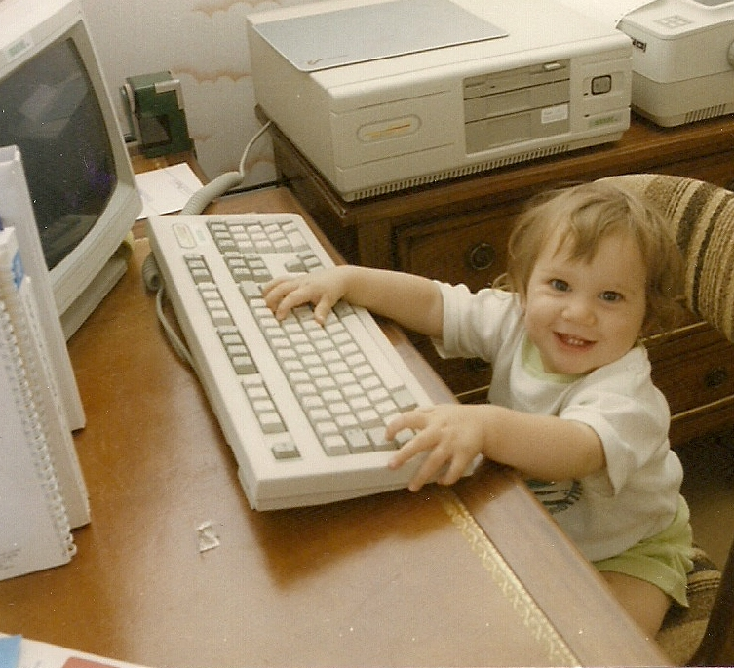
What is wrong with me?
Why can’t I just choose one thing and stick with it?
What if there was nothing wrong with me?
Why are careers seen as straight ladders and not unique windy paths?

Slide 5
You do YOU
Your career is unique because you are too.
Cherish the twists and turns, honour the breaks, celebrate the learnings.
Each part of the path, or paths, have brought you to where you are today.
Now, take a moment to breathe and enquire within… where to next?
Notes:
Acceptance > this is who I am and what my career looks like AND
Challenge > how can I continue to learn and grow + challenge the way things are so we can all grow and thrive

Slide 6
Reasonable adjustments are changeS an ORGANISATION makes to remove or REDUCE BARRIERs related to disability.
- Equality act, 2010
Notes:
That’s where reasonable adjustments come in!
Mention % disabilities that are not visible (in chat ask question)
Public bodies have anticipatory duty to implement these changes

Slide 7
Why?
IT’S TIME TO Talk about…

Slide 8
EQUALITY VS. EQUITY
It makes a difference
Notes:
More often than not, disabled people are at a disadvantage because of the barriers in society
Equity is about evening the playing field/ baseline so that everyone is included and has equal access
!!! Describe image !!!

Slide 9
A number to remember
It adds value
£249 billion
Notes:
Do you know what this number represents?
It is called the Purple Pound and is the estimated spending power of disabled households (disabled people and their families) per year in the UK.
Currently (in 2020) and is expected to increase year on year.

Slide 10
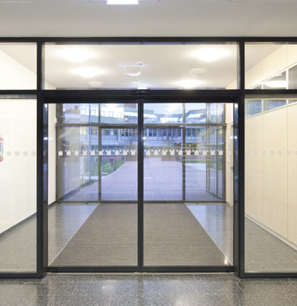
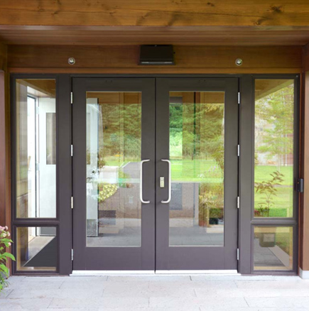
Inclusive Innovation
IT Benefits everyone
A
B
Notes:
Inclusive Innovation and Universal Design benefit everyone
Which doors would you go choose? As a wheelchair user? With a pram? With your arms full of documents?
Same goes for curbs / electric toothbrushes / noise cancelling headphones

Slide 11
WHAT?
IT’S TIME TO Talk about…

Slide 12
reasonable adjustments
What are some examples?
Physical Environment
Working arrangements
Policies & Processes
Tools & Systems
Communication style
What else…?
Notes:
In the CHAT: What’s a RA that’s been most helpful to you or that you’ve come across recently and would like to share
Physical Environment:
Ramps
Disabled toilets
Adapted equipment e.g., chair, keyboard etc.
Dimmable lights
Quiet spaces
Working arrangement:
Flexible days / hours
Working from home or hybrid
Processes:
Review absence policy to allow flexibility
Job share policy
Tools & Systems:
Assistive technology for all / on request
User manuals for tech + training and/or drop-ins
Communication:
Written vs. Video/Audio
Agenda ahead of meetings
Reminders about actions
Accessible formats
What else?

Slide 13
‘Reasonable’ adjustments
What do we mean?
What are the different options to remove or lower the barrier(s) faced?
What will be the impact for the individual and for the organisation?
What are the PROs and CONs of both implementing and not implementing the change?
How effective are each of the options?
How practical are they?
What is the cost and value of each?
What are the resources needed and available in the organisation to take action?
REACTIVE > PROACTIVE > ANTICIPATORY
Notes:
As much as possible, organisations are requested to implement reasonable adjustments before being asked to do so, in an anticipatory manner and, at least proactive. Any idea what we mean?

Slide 14
HOW?
IT’S TIME TO Talk about…

Slide 15
Asking is challenging
Why so many of us don’t ask
I didn’t know I could
What will people think/ say?
Will it impact my career progression?
I have no idea what to ask for
What if I ask and then
nothing happens?
What else…?

Slide 16
A useful framework
To prepare the conversation
DEARMAN
DESCRIBE the current situation
EXPRESS your feelings and opinions about the situation
ASSERT yourself by asking what you want
REINFORCE by explaining the positive effects
MINDFUL by staying focused on your goals
APPEAR confident, effective, and competent
NEGOTIATE being willing to give and get
Notes:
PREPARE and/or ASK A VOLUNTEER TO PRACTICE AN EXAMPLE
Describe the current situation (if necessary). Stick to the facts. Tell the person exactly what you are reacting to.
Express your feelings and opinions about the situation. Don’t assume that the other person knows how you feel.
Assert yourself by asking for what you want or saying “No” clearly. Do not assume that others will figure out what you want. Remember that others cannot read your mind.
Reinforce (reward) the person ahead of time (so to speak) by explaining positive effects of getting what you want or need. If necessary, also clarify the negative consequences of not getting what you want or need.
Mindful keep your focus on your goals. Maintain your position. Don’t be distracted. Don’t get off the topic. Speak like a “Broken record.” Keep asking for what you want. Or say “No” and express your opinion over and over and over. Just keep replaying the same thing again and again. Ignore attacks. If the other person attacks, threatens, or tries to change the subject, ignore the threats, comments, or attempts to divert you. Do not respond to attacks. Ignore distractions. Just keep making your point.
Appear confident, effective, and competent. Use a confident voice tone and physical manner; make good eye contact. No stammering, whispering, staring at the floor, retreating.
Negotiate be willing to give to get. Offer and ask for other solutions to the problem. Reduce your request. Say no, but offer to do something else or to solve the problem another way. Focus on what will work.

Slide 17
And for Leaders
Safe space and open dialogue
Create and foster safe spaces
Have conversations individually and collectively with everyone in your team about preferred ways of working and communicating
Offer and implement reasonable adjustments systematically and in an anticipatory manner
Adopt a strength and performance-based approach vs. deficit and presence-based
Consistently call in or out any behaviours that differ from these commitments
APPRECIATION
ACCEPTANCE
AWARENESS
Notes:
Explore using AXS Passport: https://www.axs-passport.co/

Slide 18
“Vulnerability sounds like truth and feels like courage. Truth and courage aren't always comfortable, but they're never weakness.”
- Brené Brown

Slide 19
Let’s Connect
LinkedIn: Solène Anglaret
Instagram: @bebeyondborders
YouTube: @bebeyondborders
Facebook: Be Beyond Borders
Website: Be Beyond Borders

Slide 20
Thank you
IT’S TIME TO Talk about…

