Slide 1
Wellbeing, safety and access from a critical perspective
Petra Boynton

Slide 2
What do we know?
High levels of dissatisfaction among students and staff
Reported increase in mental distress
Cuts to external support services and charities, plus increased demand for them
‘Academic mental health’ has become a hot topic
Research on this subject variable in quality and impact
Solutions ignored in spite of a legacy of work around inequalities, access and harms
Much of the research and practice is depoliticised, ignores diverse experiences and needs, and does not hold institutions accountable

Slide 3
What’s going on inside universities?
Rapid transitions on/offline teaching and learning
Extractive practices
Student and staff histories, needs and changing circumstances
Relocation
Loneliness and isolation
Emphasis on research but patchy or poor research tuition and dissertations impacted
Access, safety and wellbeing (including studying sensitive topics and secondary data)
Silo working
Research waste
Violence on campus, within the university system, enacted by academia
Drop outs, leavers-by-choice, redundancy
Legal changes and challenges
Industrial action (all sectors)
Publish or perish
Metrification
Competition and glorifying overwork
Precarity
Funding cuts/deficits - “I have to pay to work”
Bureaucracy
“Suffering is a badge of honour”
PGRs adversely affected
Low wages
Pensions and pay
Bullying and sexual harassment
Inadequate training, supervision, instruction and equipment
“I don’t know what I’m doing”
Visa/access
Hidden curriculum

Slide 4
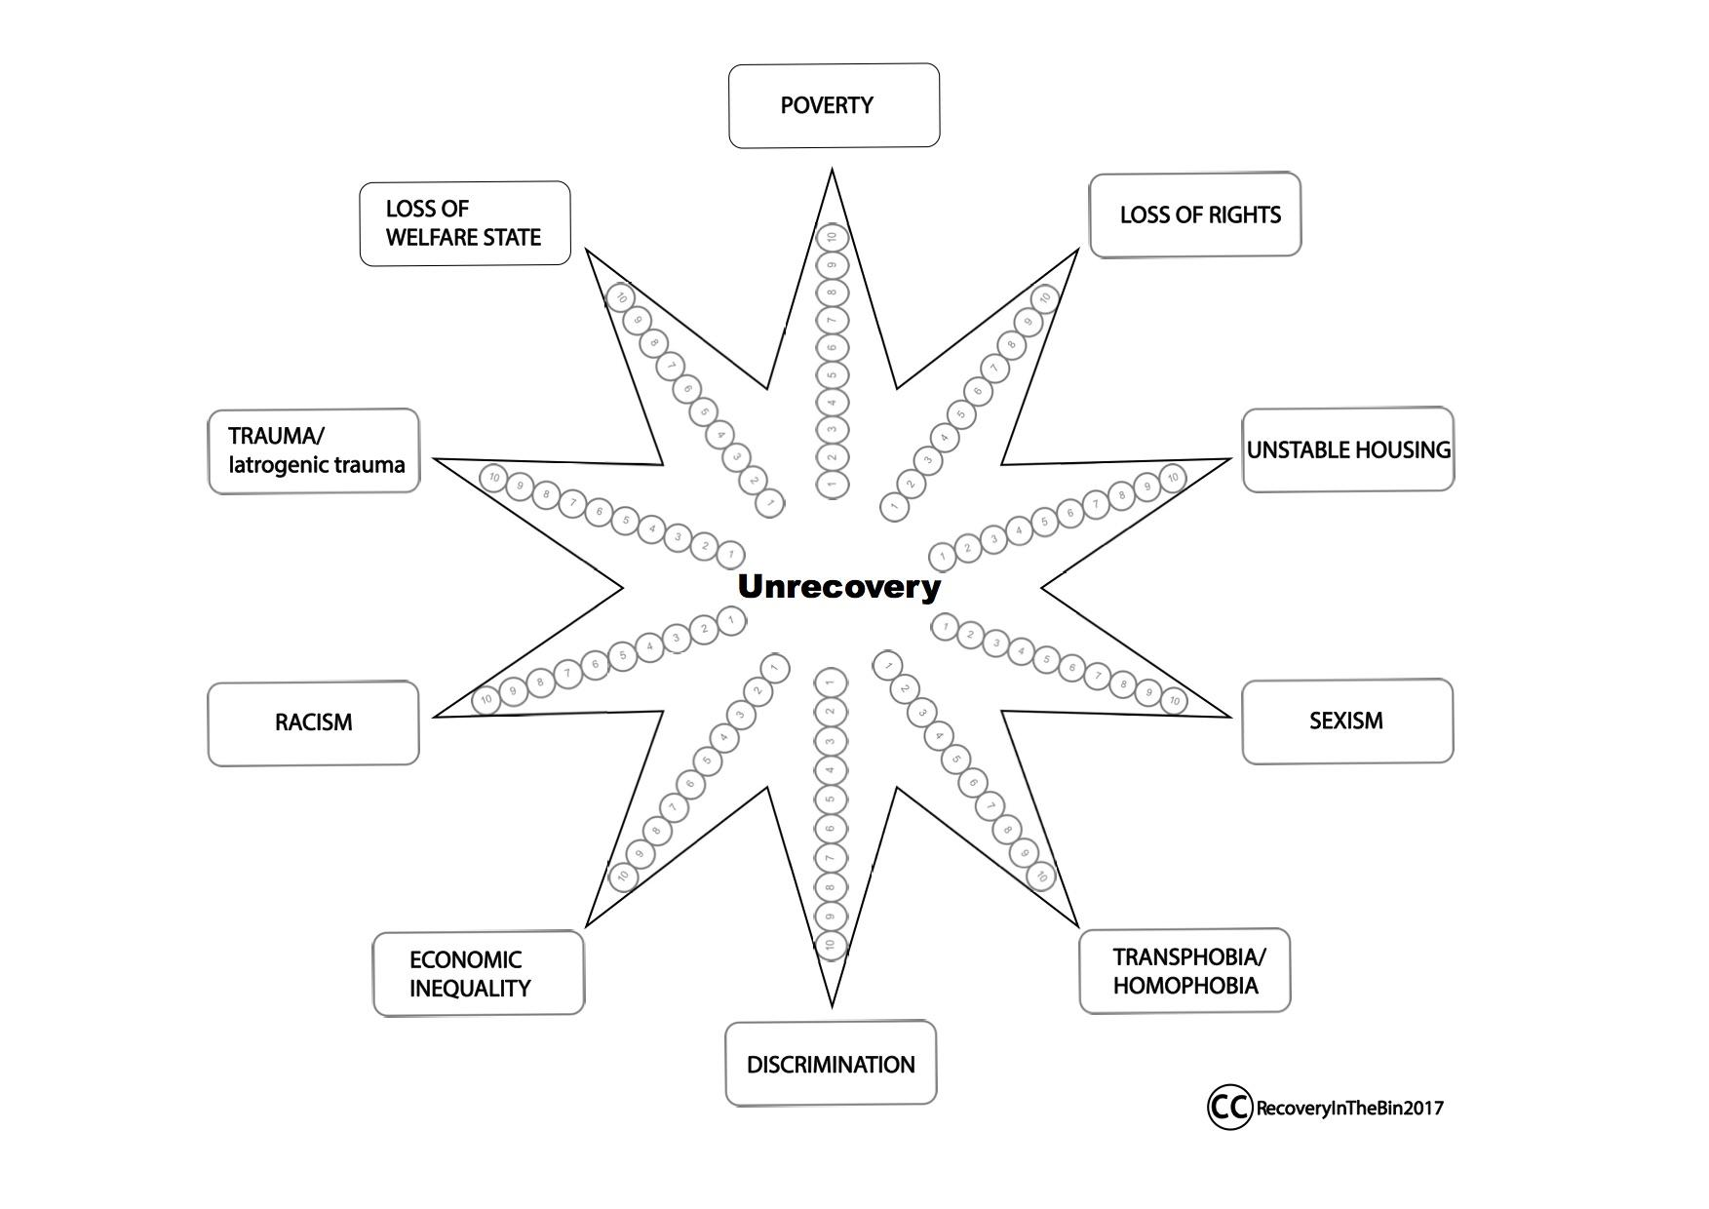
The Unrecovery Star - Recovery in the Bin (2017)

Slide 5
Students and staff who are vulnerable
Low income
Estranged
Working class
From an ethnic minority
Disabled
Have learning difficulties
Physically or mentally ill
Parents or carers
Care leaver
Self-funding
Refugee or asylum seeker
Part time
LGBTQ+
On placement or doing fieldwork
International
Older/mature
Working or studying remotely
Women
Indigenous
First-gen
Bereaved
Trauma and/or SEMH

Slide 6
Nothing will change if it is the universities, research councils, and other educational institutions that are causing or worsening our difficulties.

Slide 7
How to stay in control (even) when you don’t feel like it
Keep records/receipts
Correspond via email
Gather witnesses
Use mentors/third-party support
Know and cite regulations
Create a support network
Sign up to a Hub
Report issues!
Coaching/counselling

Slide 8
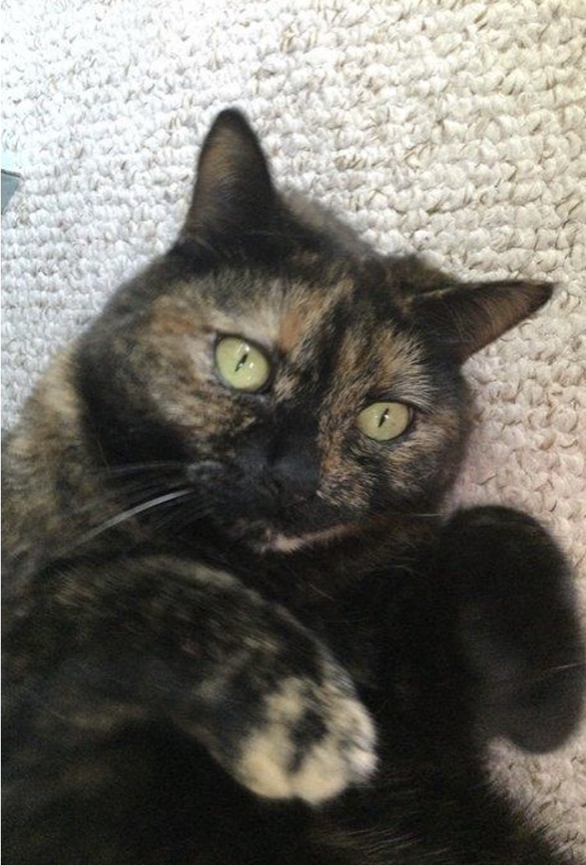
Ways to comfort yourself

Slide 9
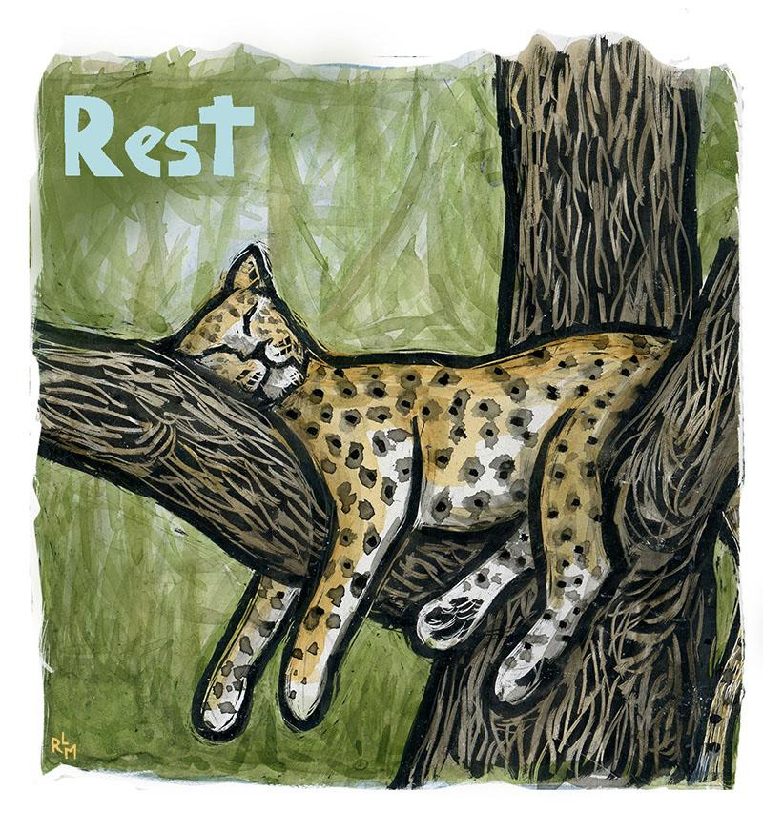
Rest periods and holidays
Hobbies (e.g. sport, crafting, cooking)
Bathing, hair washing, or brushing
Venting and righteous anger
Catching up with friends and family
Being in nature
Gentle exercise
Try anxiety busting techniques
Film or TV (favourite shows)
Relaxation and meditation
Reading or listening to stories
Pick your own treats
Care for yourself as you would your phone!

Slide 10
Alternatives to ‘resilience’
Persistence
Fortitude
Resistance
Rebellion
Defiance
Stubbornness
Obstinacy
Tenacity
Bravery
Humour
“No ought without support”

Slide 11
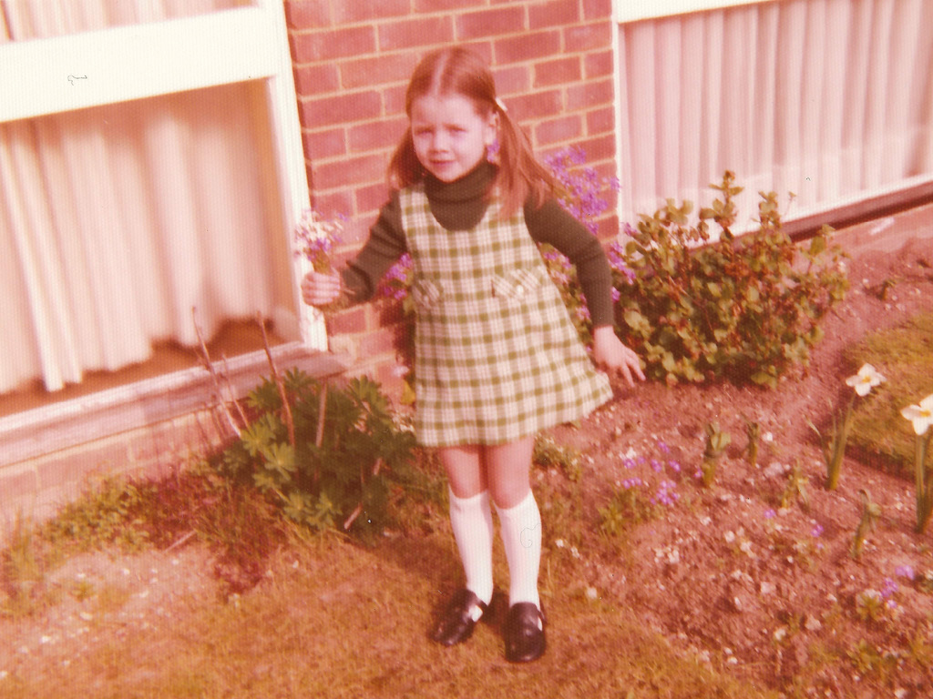
“She thinks she can read, but she can’t”
“I see absolutely nothing in her”
“Show off”
“Chatterbox”
“Fidget bottom”
“Thick”
“Incompetent”
“Could try harder”
“Defiant”
“Careless”
“Lazy”
“Moody”
“Dolly day dream”
“Challenging”
“Distracting”
“Flighty”
“Certainly I did not single her out among our students as a high flyer”
Notes:
Billy Connolly ‘Stupid but saveable’ Robbie Williams “I’m the kid who wouldn’t amount to much”

Slide 12
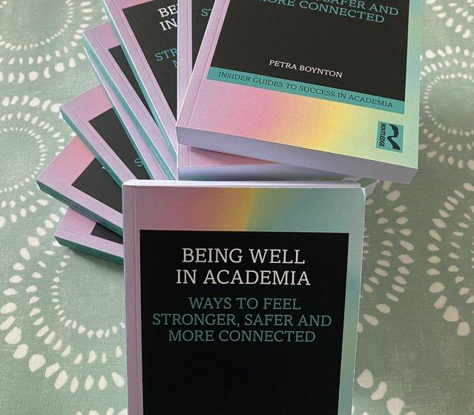
Thanks for listening!
info@drpetra.co.uk

