Slide 1
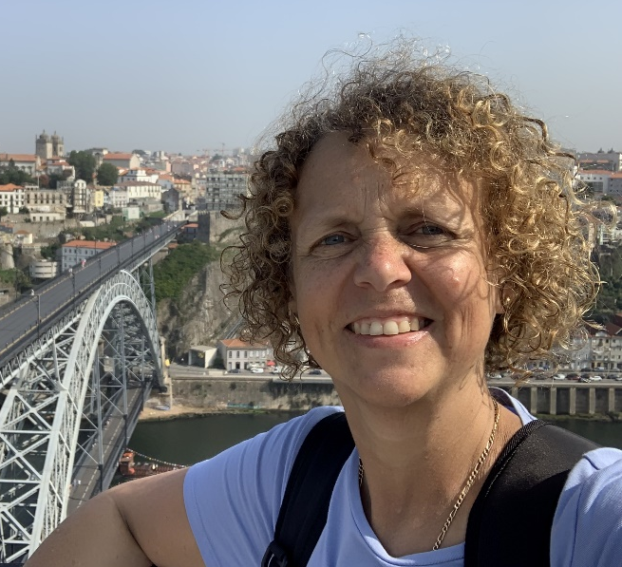
Bodies and buildings: The lived experience of disability, chronic illness and/or neurodivergence in academia
Dr Nicole Brown
@AbleismAcademia @ncjbrown
www.nicole-brown.co.uk
nicole.brown@ucl.ac.uk

Slide 2
Overview
Context and background to research
Introduction to Embodied Inquiry
Findings
Recommendations for practice

Slide 3
Context and background
Previous "Ableism in Academia" research
challenge of managing disability and others' emotions
lack of role models
HESA statistics
underrepresentation of disabled
drop-off at transition points
Disclosure as a cost-benefit analysis

Slide 4
Disclosure is a cost-benefit analysis
BENEFIT
COST
Brown, N. (2020). Disclosure in academia: A sensitive issue. In: Brown, N., & Leigh, J. (eds.). Ableism in Academia: Theorising Experiences of Disabilities and Chronic Illnesses in Higher Education. London: UCL Press, 226-236.

Slide 5
Introduction of Embodied Inquiry
focus on bodily and embodied experiences
lived experiences, the researcher’s body in the field, the body as a communicator and the body in interaction
theoretical foundations in phenomenology and hermeneutics
cornerstones of human understanding/communication
human understanding is embodied, language is insufficient and inexact, communication and understanding are metaphorical

Slide 6
Data in Embodied Inquiry
Embodied Inquiry sees knowledge as produced and relational, contextual, multimodal and the researcher as a data traveller
Process:
Visual representation of experience in higher education
Conversation

Slide 7
Participants
Recruited via social media to opt-in
12 participants (10:2), 1 person dropped out
Wide range of disabilities:
one wheelchair user, one participant using a white cane; 3 participants with one or several neurodiversities: autism, Asperger's syndrome, dyslexia, dyspraxia and attention deficit and hyperactivity disorder (ADHD); several participants have diagnoses related to mental health issues, such as depression and bipolar disorder, either on their own or in conjunction with the psychosomatic condition fibromyalgia; other conditions and disabilities mentioned were narcolepsy, asthma, chronic migraine, cystitis, irritable bowel syndrome, postural tachycardia syndrome (POTS) and traumatic brain injury following an accident; PLUS: fatigue, sensory overload, headaches and nausea

Slide 8
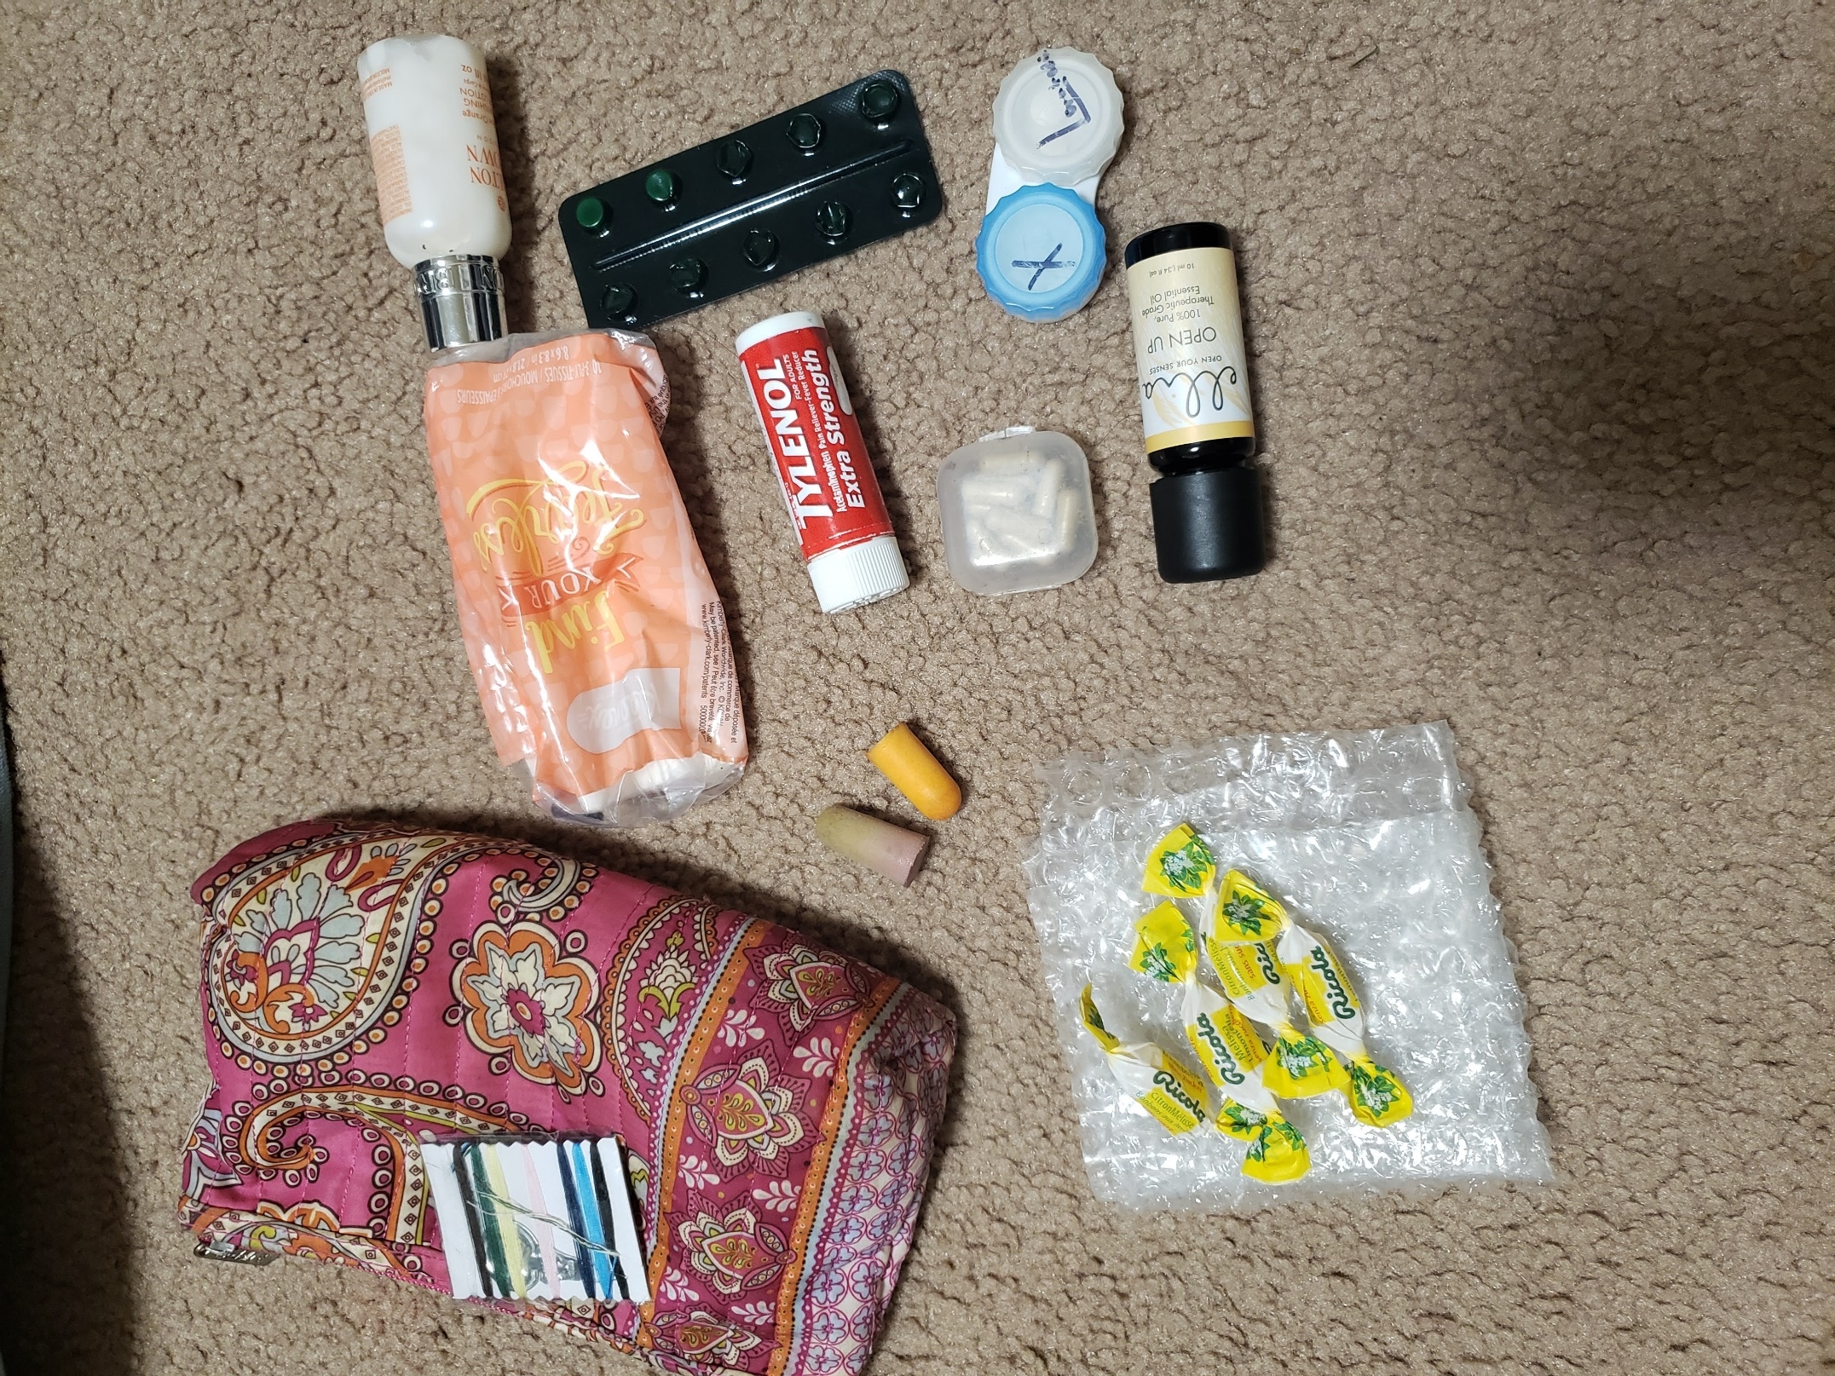

Slide 9
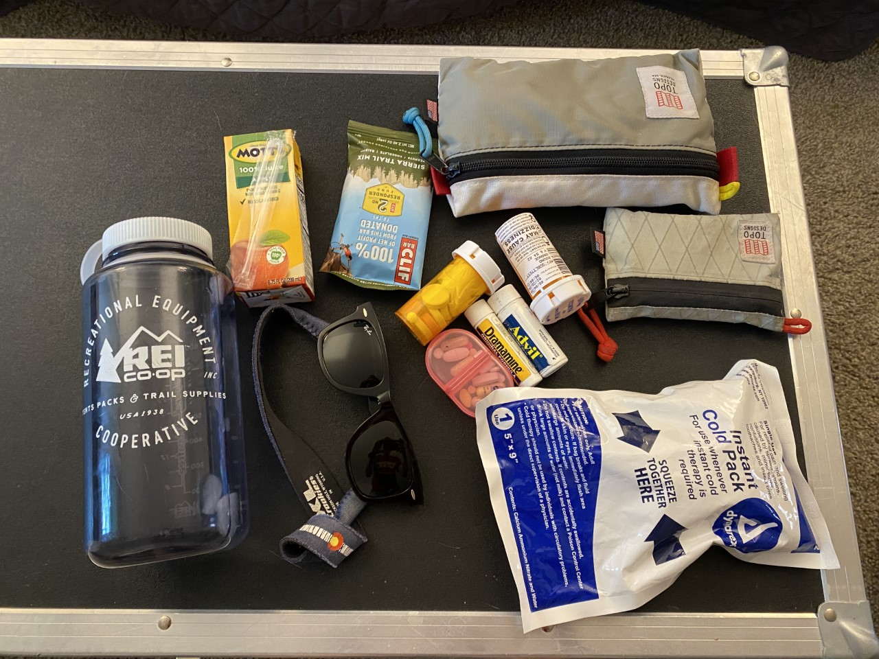

Slide 10
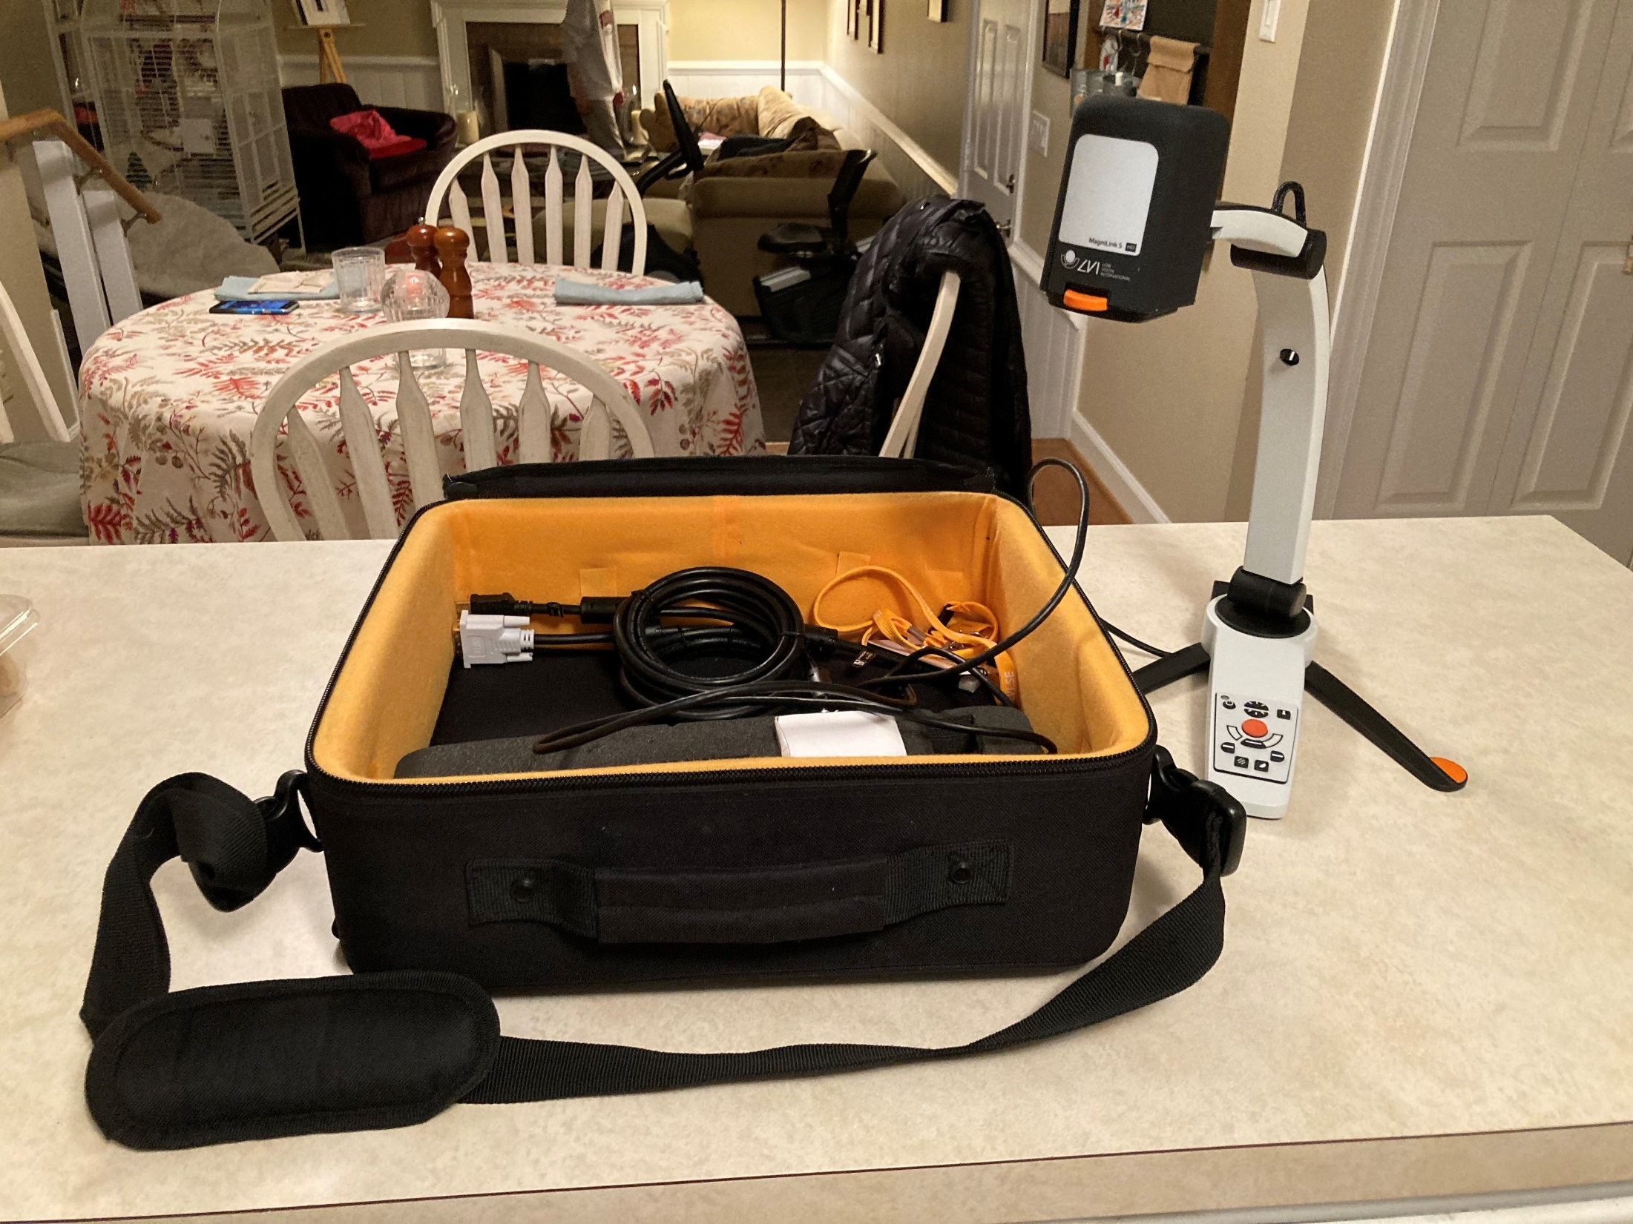

Slide 11
Analysis
Thematic Analysis (Braun and Clarke, 2006, 2019)
iterative
inductive
semantic
reflexive
Exploratory, creative analysis in line with Embodied Inquiry
Notes:
An inductive way – coding and theme development are directed by the content of the data
A semantic way – coding and theme development reflect the explicit content of the data rather than concepts underpinning the data
Familiarisation with the data | This phase involves reading and re-reading the data, to become immersed and intimately familiar with its content.
Coding | This phase involves generating succinct labels (codes!) that identify important features of the data that might be relevant to answering the research question. It involves coding the entire dataset, and after that, collating all the codes and all relevant data extracts, together for later stages of analysis.
Generating initial themes | This phase involves examining the codes and collated data to identify significant broader patterns of meaning (potential themes). It then involves collating data relevant to each candidate theme, so that you can work with the data and review the viability of each candidate theme.
Reviewing themes | This phase involves checking the candidate themes against the dataset, to determine that they tell a convincing story of the data, and one that answers the research question. In this phase, themes are typically refined, which sometimes involves them being split, combined, or discarded. In our TA approach, themes are defined as pattern of shared meaning underpinned by a central concept or idea.
Defining and naming themes | This phase involves developing a detailed analysis of each theme, working out the scope and focus of each theme, determining the ‘story’ of each. It also involves deciding on an informative name for each theme.
Writing up | This final phase involves weaving together the analytic narrative and data extracts, and contextualising the analysis in relation to existing literature.

Slide 12
Findings
Management of the buildings
nowhere to rest, scents and smells, staircases
Consideration about career – adjustments not helpful
Social and emotional loneliness

Slide 13
Disclosure is a cost-benefit analysis
BENEFIT
COST
Brown, N. (2020). Disclosure in academia: A sensitive issue. In: Brown, N., & Leigh, J. (eds.). Ableism in Academia: Theorising Experiences of Disabilities and Chronic Illnesses in Higher Education. London: UCL Press, 226-236.

Slide 14
Recommendations for practice
Challenging our own assumptions
Involving individuals in processes and decisions
e.g. moving tables/desks
Sharing our own struggles

Slide 15
Bodies and buildings: The lived experience of disability, chronic illness and/or neurodivergence in academia
Dr Nicole Brown
@AbleismAcademia @ncjbrown
www.nicole-brown.co.uk
nicole.brown@ucl.ac.uk

Slide 16
https://www.uclpress.co.uk/products/123203
Ableism in Academia provides an interdisciplinary outlook on ableism that is currently missing. Through reporting research data and exploring personal experiences, the contributors theorise and conceptualise what it means to be/work outside the stereotypical norm.
The volume brings together a range of perspectives, including feminism, post-structuralism, crip theory and disability theory, and draws on the width and breadth of a number of related disciplines. Contributors use technicism, leadership, social justice theories and theories of embodiment to raise awareness and increase understanding of the marginalised.

Slide 17
https://policy.bristoluniversitypress.co.uk/lived-experiences-of-ableism-in-academia
Demands for excellence and efficiency have created an ableist culture in academia. What impact do these expectations have on disabled, chronically ill and neurodiverse colleagues?
This important and eye-opening collection explores ableism in academia from the viewpoint of academics' personal and professional experiences and scholarship. Through the theoretical lenses of autobiography, autoethnography, embodiment, body work and emotional labour, contributors present insightful, critical, analytical and rigorous explorations of being ‘othered’ in academia.
Deeply embedded in personal experiences, this perceptive book provides examples for universities to develop inclusive practices, accessible working and learning conditions and a less ableist environment.

