Slide 1
Fair Employment of Autistic Researchers: Identifying and Addressing Barriers
https://employmentautism.org.uk/news/conference-2023/
CADS conference
https://www.youtube.com/watch?v=JvQfc1BSXFQ
Inaugural lecture by Professor Nicola Martin
https://www.lsbu.ac.uk/about-us/people/people-finder/dr-nicola-martin

Slide 2
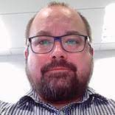
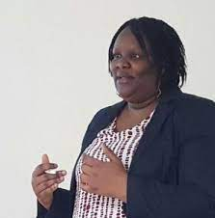
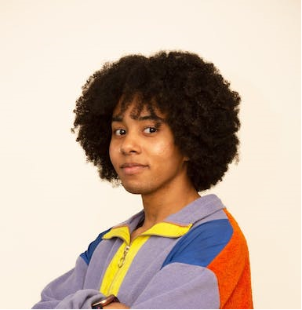
CADS
The Critical Autism and Disability Studies (CADS) research group at LSBU (amongst other things) seeks to understand and address barriers faced by autistic people in relation to gaining, keeping and progressing in employment in academic roles in our universities.

Slide 3
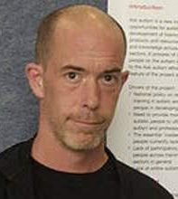
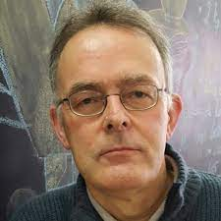
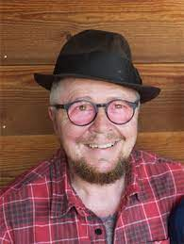
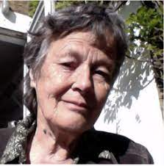
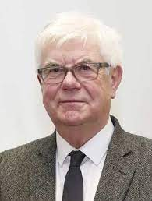
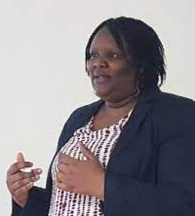
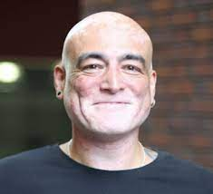
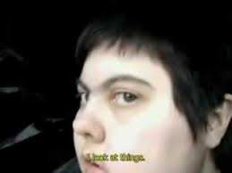
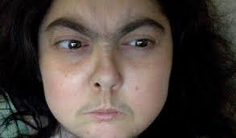
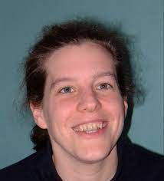
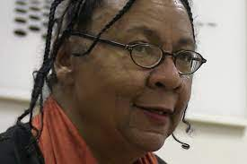
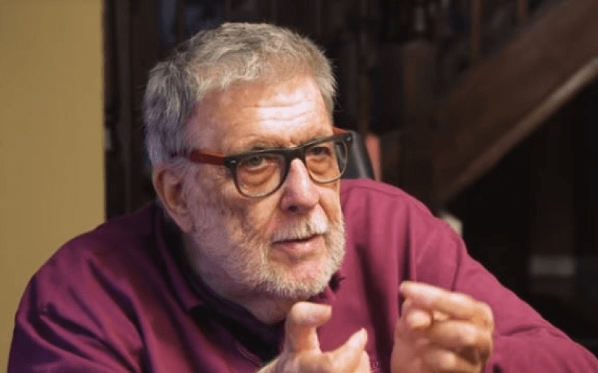
Influences

Slide 4
National strategy for autistic children, young people and adults: 2021 to 2026 Autistic involvement in this agenda? Moving beyond tokenism…
Priorities:
health
education
employment
social care
criminal justice
community

Slide 5
The Buckland Review
Autism Employment Review

Slide 6
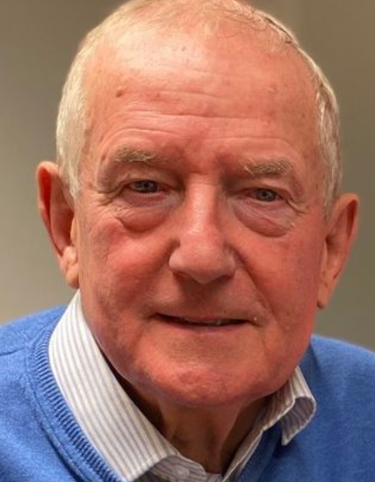
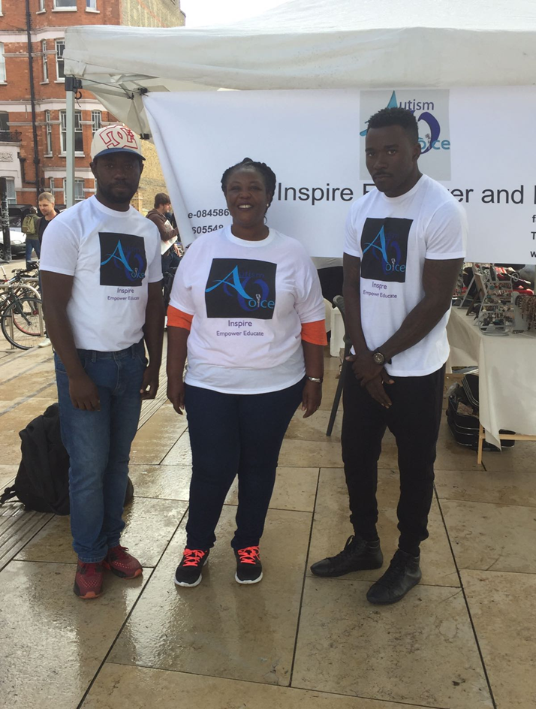
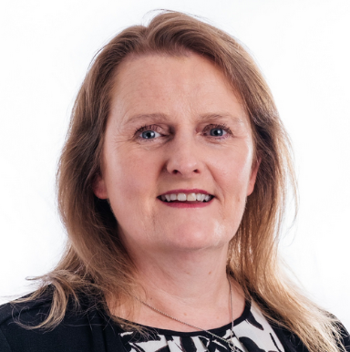
Collaborators

Slide 7
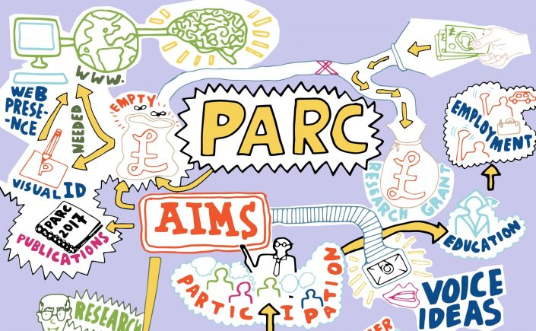
PARC Milton et al (2019)

Slide 8
Stakeholder informed (involved-controlled) Useful Respectful Ethical
Emancipatory Research
The thorny issue of allyship
Milton (2017)

Slide 9
Participatory Research
‘At the lowest end … forms of non-participation are used by powerful actors to impose their agendas… tokenism… participants hear about interventions… may say something about them, which power holders denote as ‘input’… voices of participants will not have any effect on the intervention;… does not lead to change.
At the higher end… participation is about citizens having more power to negotiate and change the status quo. Their voices are heard and responded to’.
Levels of Participation | Participatory Methods;Institute of Development Studies Accessed 08-09-22

Slide 10
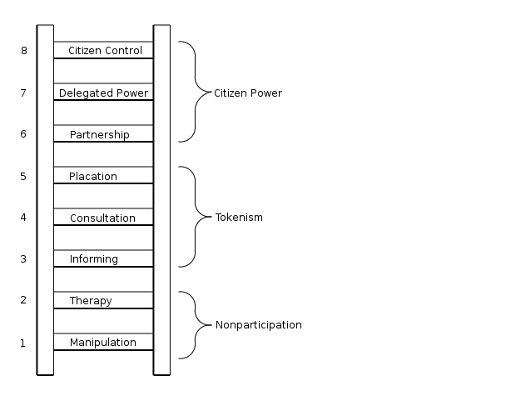
Arnstein’s 1969 ladder of citizen participation Levels of Participation | Participatory Methods;Institute of Development Studies Accessed 08-03-21

Slide 11
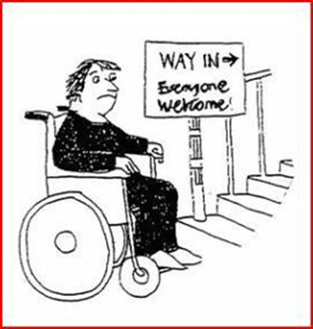
Interdisciplinary Collaborative Research
Themes
Inclusive:
Education
Employment
Health and Social Care
Older age
Mentoring
Research
Social Model thinking
Oliver (2013)

Slide 12
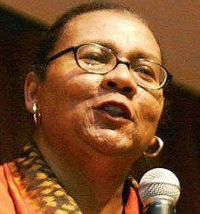
Autistic strengths
‘Beloved community is formed not by the eradication of difference but by its affirmation, by each of us claiming the identities and cultural legacies that shape who we are and how we live in the world’.
bell hooks
Monotropism (Murray2018) - In-depth interests
Application /productivity
Reliability /integrity
Community building /mutual support /Empathy
Energy /enthusiasm

Slide 13
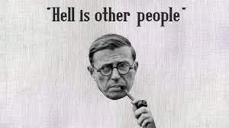
Autistic challenges
Access to diagnostic / post-diagnostic services /services which are behind a wall
Educational exclusion /unemployment / underemployment /poverty
Stereotyping /threats to autonomy /agency
A treacle of bureaucracy /navigating chaos

Slide 14
Reasonable adjustments are often cheap and easy and benefit everyone
Embedding Universal Design (UD) reduces the requirement for reasonable adjustment
UD is about planning for diversity rather than being surprised that there is no such person as ‘Mythical Norm’
Autistic people know what they need
Nobody thrives in chaos

Slide 15
People and systems need to reliably do what they say they are going to do
Planning needs to be built on empathically, looking at situations from various perspectives and enacting the anticipatory duties of the 2010 Equality Act by planning for diverse participation
Logical workable systems communicated clearly make life easier and more productive for everyone
Reliable
Empathic
Anticipatory
Logical

Slide 16
Services are often ineffective
Universities do not always have support in place for autistic students at the start of their course and services are not necessarily appropriate for doctoral candidates
Employment services such as Access to Work do not easily translate into useful support

Slide 17
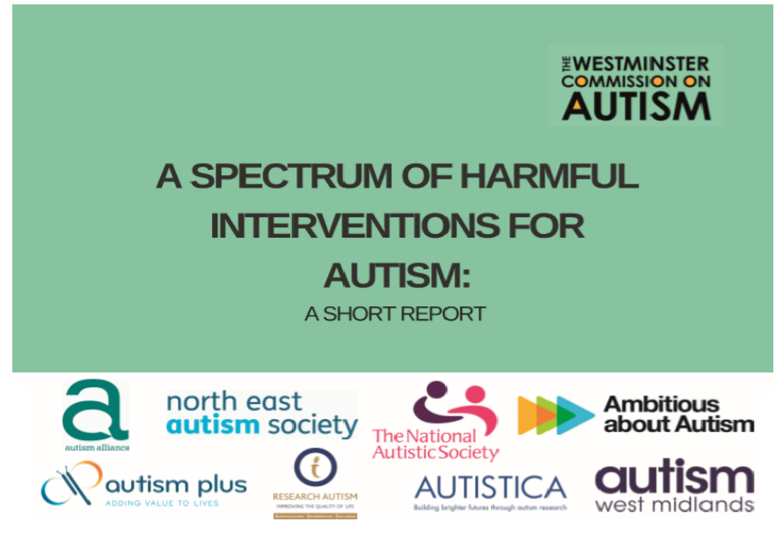
Diagnosis /post diagnostic support
Falling between learning disability& mental health services
Autistic people who do not use words and older family carers are often not heard
GP Health checks are not uniformly available & do not cover dentistry or mental health. Medical practitioners are not well informed about autism

Slide 18
A way forward
Joined-up autism research would be useful as various funders fund similar projects
Real participation of autistic people in research which is informed by the priorities of autistic people (Pellicano, et al 2014)
Autistic researchers would benefit from stable employment contracts
Support for organisations such as PARC

Slide 19
Sample Publications (co-authored with autistic researchers and-or focussing on employment in academia)
Human Rights: The Right to Work in Academia Birchall, D. and Martin, N. (2023). Human Rights: The Right to Work in Academia. Journal of Inclusive Practice in Further and Higher Education. 15 (1), pp. 75-101.
Healthcare Barriers, Health Outcomes, and Annual Health Checks for Autistic Adults: A Cross-Sectional Study of General Practitioners’ Knowledge, Attitudes and Practices Chown et al (2022). Healthcare Barriers, Health Outcomes, and Annual Health Checks for Autistic Adults: A Cross-Sectional Study of General Practitioners’ Knowledge, Attitudes and Practices. Canadian Journal of Educational and Social Studies. 2 (4), pp. 179-199. https://doi.org/10.53103/cjess.v2i4.57
General Practitioner Autism Training and Mandatory Medical Training: A Cross-Sectional Study of GPs’ Knowledge, Attitudes and Practices Chown, N et al (2023). General Practitioner Autism Training and Mandatory Medical Training: A Cross-Sectional Study of GPs’ Knowledge, Attitudes and Practices. Canadian Journal of Educational and Social Studies. 3 (1), pp. 1-16. https://doi.org/10.53103/cjess.v3i1.99

Slide 20
A Practical Response to Ableism in Leadership in UK Higher Education Martin, N. (2019). A Practical Response to Ableism in Leadership in UK Higher Education. in: Brown, N. and Leigh, J. (ed.) Ableism in Academia UCL Press.
University through the eyes of autistic students and staff Martin, N. (2020). University through the eyes of autistic students and staff. in: Milton, D. (ed.) Neurodiversity Reader
Perspectives on UK university employment from autistic researchers and lecturers Martin, N. (2020). Perspectives on UK university employment from autistic researchers and lecturers. Disability & Society. 36 (9), pp. 1510-1531. https://doi.org/10.1080/09687599.2020.1802579
Practical Scholarship: Optimising Beneficial Research Collaborations Between Autistic Scholars, Professional Services Staff and ‘Typical Academics’ in UK Universities Martin, N. (2020). Practical Scholarship: Optimising Beneficial Research Collaborations Between Autistic Scholars, Professional Services Staff and ‘Typical Academics’ in UK Universities. in: Chown, N. (ed.) Neurodiversity: A New Critical Paradigm Routledge.

Slide 21
A critical reflection on the development of the Participatory Autism Research Collective (PARC) Milton, D, Ridout, S, Kourti, M, Loomes, G and Martin, N (2019). A critical reflection on the development of the Participatory Autism Research Collective (PARC). Tizard Learning Disability Review. https://doi.org/10.1108/TLDR-09-2018-0029
Identifying and Addressing Barriers to Employment of Autistic Adults Martin, N, Barnham, C and Krupa, J (2019). Identifying and Addressing Barriers to Employment of Autistic Adults. Journal of Inclusive Practice in Further and Higher Education. 10 (1), pp. 56-77.
Does 'mentoring’ offer effective support to autistic adults?: a mixed methods pilot study Martin, N, Milton, D, Sims, T, Dawkins, G, Baron-Cohen, S and Mills, R (2017). Does 'mentoring’ offer effective support to autistic adults? a mixed methods pilot study. Advances in Autism. 3 (4). https://doi.org/10.1108/AIA-06-2017-0013

Slide 22
Fertig, H., Martin, N. and Waltz, M. (2021) (Eds.) Autism and Employment. Advances in Autism, Vol. 7 No. 1 https://doi.org/10.1108/AIA-01-2021-0007
Autism in Black, Asian and Minority Ethnic Communities: A Report on The First Autism Voice UK Symposium Kandeh, M.S., Kandeh, M.K., Martin, N. and Krupa, J. (2020). Autism in Black, Asian and Minority Ethnic Communities: A Report on The First Autism Voice UK Symposium. Advances in Autism. 6 (2), pp. 165-175. https://doi.org/10.1108/AIA-12-2018-0051
Encouraging disabled leaders in higher education: recognising hidden talents Martin, N (2017). Encouraging disabled leaders in higher education: recognising hidden talents. Leadership Foundation for Higher Education.
Examining intellectual prowess, not social difference: Removing barriers from the doctoral viva for autistic candidates Chown, N, Beardon, L, Martin, N and Ellis, S (2016). Examining intellectual prowess, not social difference: Removing barriers from the doctoral viva for autistic candidates. Journal of Inclusive Practice in Further and Higher Education. 6 (1), pp. 22-38.

Slide 23
Useful References
Barton, L. (2005) "Emancipatory research and disabled people: Some observations and questions." Educational review 57, no. 3: 317-327.
Brosi, G. and Hooks, B. (2012). The beloved community: a conversation between bell hooks and George Brosi. Appalachian Heritage, 40(4), pp.76-86.
Brown, N. and Leigh, J. (2020). Ableism in Academia: Theorizing experiences of disabilities and chronic illnesses in higher education (p. 241). UCL Press.
Charlton, J.I. (1998). Nothing about us without us. In Nothing About Us Without Us. University of California Press.
Milton, D., 2017. A mismatch of salience: Explorations of the nature of autism from theory to practice. Pavilion Press.

Slide 24
Murray, D., 2018. Monotropism–an interest based account of autism. Encyclopedia of autism spectrum disorders, 10, pp.971-978.
Oliver, M., 2013. The social model of disability: Thirty years on. Disability & Society, 28(7), pp.1024-1026.
Pellicano, et al 2014. What should autism research focus upon? Community views and priorities from the United Kingdom. Autism, 18(7), pp.756-770.
Rosqvist, H., Chown, N. and Stenning, A. (Eds) Neurodiversity Studies: A New Critical Paradigm. Abingdon: Routledge
Sims, T.et al ( 2016). Developing a user-informed training package for a mentoring Programme for people on the autism spectrum. Journal of Inclusive Practice in Further and Higher Education, 7, pp.49-52. (Personal Construct Theory)

