Slide 1
Challenges in doing practical research
Katherine Deane
University of east Anglia
k.deane@uea.ac.uk

Slide 2
Survey of lab accessibility
Recruited scientists with interest in lab access
152 respondents
55% disabled, 93% experience of lab working, 87% UK based
Biology & biomedical dominated, mostly in universities or healthcare settings
Invisible impairments most common
Notes:
Recruited quickly - over 1 month
Fatigue 91%, pain 80%, brain fog 77%, mood 74%, neurodiversity 53%

Slide 3
“My lab broke me –
I hope others are better”

Slide 4
Survey results
Structural access to buildings and labs is poor
Behaviour, attitudes, and knowledge is poor
Initiatives to change ableism are tokenistic and ineffective
Web pages and conferences are often inaccessible
Poor access = poor safety, unlawful practices, poor recruitment, poor retention
Suite of access guidelines

Slide 5
Lab accessibility targets – behaviour – immediate to 5 years
Audit PEEPs and lone working plans
Implement reasonable accommodations passport into annual reviews
Normalise reasonable workloads and flexible working
Allyship and bystander training
All staff responsibility for fault reporting
Mentorship programs
Access hackathons/ Pride events
Access to external advocacy expertise

Slide 6
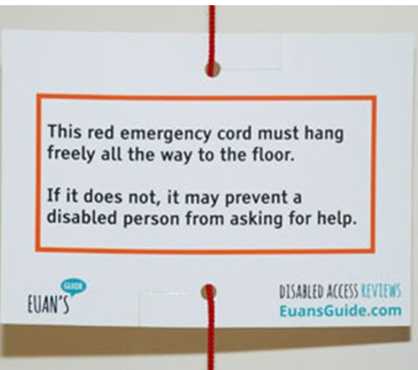
Lab accessibility targets Structural - immediate
New builds and refurbishments to guideline standards
New equipment and its placement to guideline standards
Evac chairs or alternatives
Microphones, PA systems, and portable hearing loops
Euan’s guide red cord cards
Colour contrast in accessible toilets (pot of paint)

Slide 7
Lab accessibility targets Structural & equipment – 5 years
Funders require minimum access standards for eligibility for funds
Includes mandatory training and audits
An accessible toilet in any building with standard toilets
Dual alert fire alarms
Equipment connectivity standards
Hearing technology standards
Ergonomics – seating, lighting, acoustic environment
Key routes – light doors, step free
Lever taps and D handles
Changing Place accessible toilets within 20 min

Slide 8
Lab accessibility targets Structural & equipment – 10 years
“Maximum” access requirements necessary for funding
Disinvest / repurpose buildings that cannot be made accessible
Where possible
Fire safe lifts
Step free fire exits
Most routes – light doors, step free
Changing Place accessible toilets within 10 min
Accessible fieldwork, boats, planes, etc etc

Slide 9
Funding access
Flexible deadlines
Flexible duration – FT/PT/ extensions
Flexible working - WFH
Flexible roles – shared PI
Separate researcher reasonable accommodation fund
Rapid response research access fund (2 weeks)
E.g. BSL interpreters for interviews
Fund accessible practice for events
Prizes

Slide 10
Research design access
EXPECT DISABLED PARTICIPANTS
Good quality PE/ PPI
Audit EDI of researchers & participants
Accessible written info
Simple
Clear text/ large font etc
“How we made this project accessible” section in info sheet
PI/ Ethics committee training
Budget for access costs
Venues
BSL, captions, audio descriptions, videos, Easy Read
Carers, travel, food, etc.

Slide 11
References
Deane KHO and the Access All Areas in Labs Team. 2023. Access All Areas in Labs: Access Guidelines. Version 1. March 2023. University of East Anglia, Norwich. https://www.uea.ac.uk/web/groups-and-centres/projects/access-all-areas-in-labs
Deane K, Delbecque L, Gorbenko O, et al. Co-creation of patient engagement quality guidance for medicines development: an international multistakeholder initiative. 2019 BMJ Innovations. 13. https://innovations.bmj.com/content/5/1/43 (Table 3)
Schroeder K, Bertelsen N, Scott J, Deane K, et al. Building from Patient Experiences to Deliver Patient-Focused Healthcare Systems in Collaboration with Patients: A Call to Action. 2022. Therapeutic Innovation & Regualtory Science. https://doi.org/10.1007/s43441-022-00432-x
Brage T, Lövkrona I, Eldh C, et al. (2016). Core values work in academia: – with experiences from Lund University. Lund University https://eige.europa.eu/sites/default/files/core_values_work_brage_lovkrona.pdf

Slide 12
Other talks
Lab access sucks – so here are guidelines to start solving this. Vitae 2023. https://www.youtube.com/watch?v=j9H9tdPjpQw&t=10s
Change Makers Toolkit (with a disability focus). Vitae 2023. https://www.youtube.com/watch?v=oWuX-8iO73s
Starting Change Making. Cultural Forum Norwich. 2022. https://youtu.be/XZ72o4fbuh8
Values, disability, saying no, and how fabulous it is to fail during the research process. 2021 https://emmaelvidge.wordpress.com/2021/10/26/episode_2_katherine_deane/
Benefits of being a Disabled Scientist. UK Association for Science and Discovery Centres. 2020 https://www.youtube.com/watch?v=vjMHySCxY2k&feature=youtu.be

Slide 13
Contact details and thanks
https://www.uea.ac.uk/web/groups-and-centres/projects/access-all-areas-in-labs
k.deane@uea.ac.uk

