Slide 1
Ableism in Academia
Dr Jennifer Leigh, SSPSSR/LSSJ, University of Kent
J.S.Leigh@kent.ac.uk
@DrSchniff

Slide 2
What is equity?
What is not equitable?

Slide 3
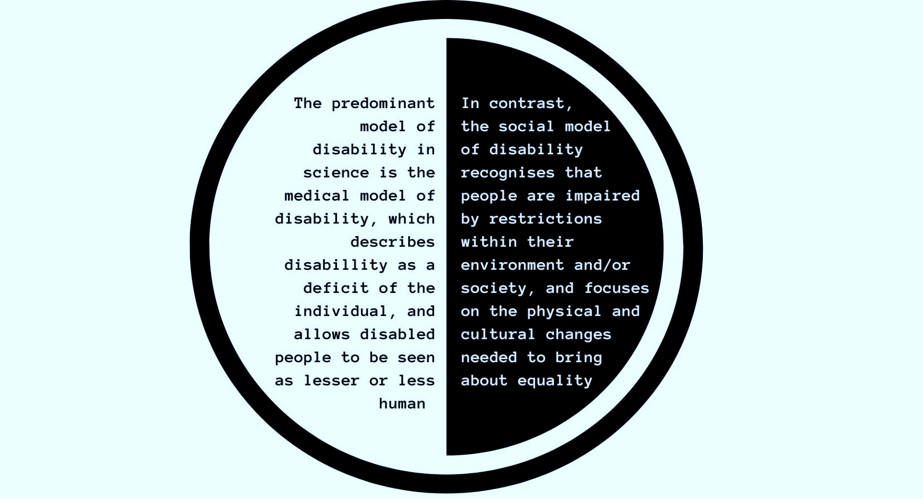
Models of disability

Slide 4
What is not equitable?

Slide 5
“In 2020 the employment rate for disabled people was 51.8%, compared to 81.6% for non-disabled people.”
TUC.org.uk

Slide 6
“Disabled people are made to feel grateful for having a job at all”
Frances Ryan, The Guardian, 2018

Slide 7
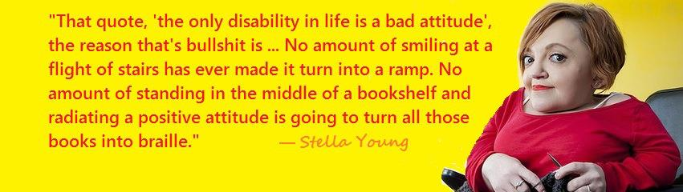
“Disability doesn’t make you exceptional, but questioning what you know about it does”

Slide 8
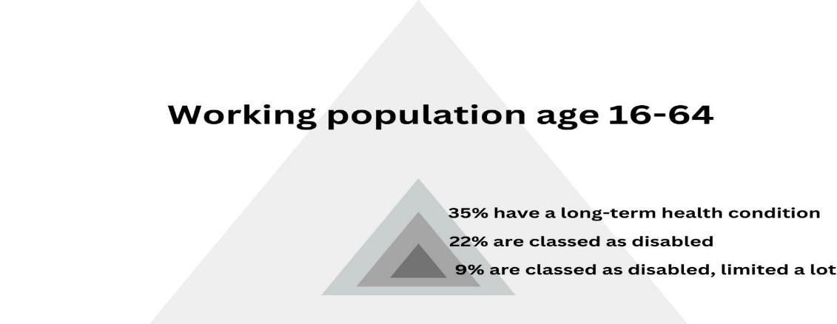
How many people are disabled?
Proportion of the population with a long-term health condition, classed as disabled, including those limited a lot, people aged 16 to 64 years, UK, 2021/2022 (Office for National Statistics)

Slide 9


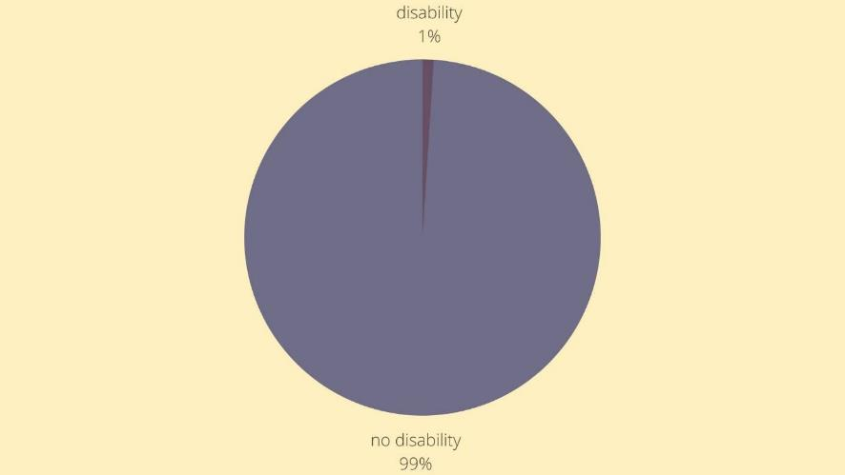
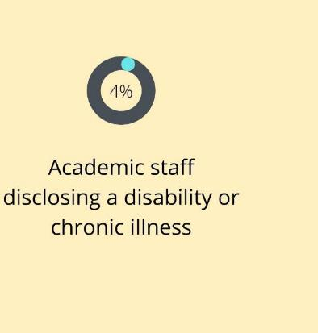
In Higher Education
“Only 25% of disabled researchers apply for funding across all disciplines, with the average success rate and award amount consistently lower for disabled researchers than non-disabled researchers”
TigerInSTEMM.org

Slide 10
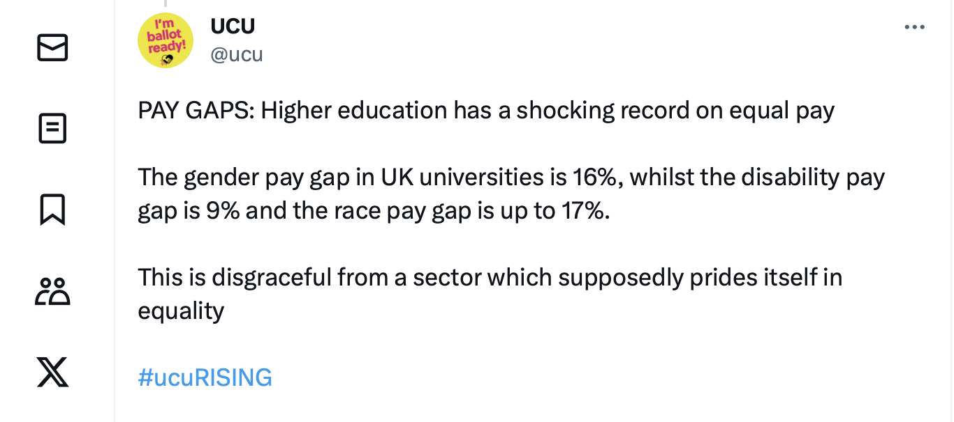
Pay gaps

Slide 11

“The STEMM workforce is less diverse than the wider workforce”
(Report July 2021 All-Party Parliamentary Group on Diversity and Inclusion in STEMM | British Science Association)

Slide 12
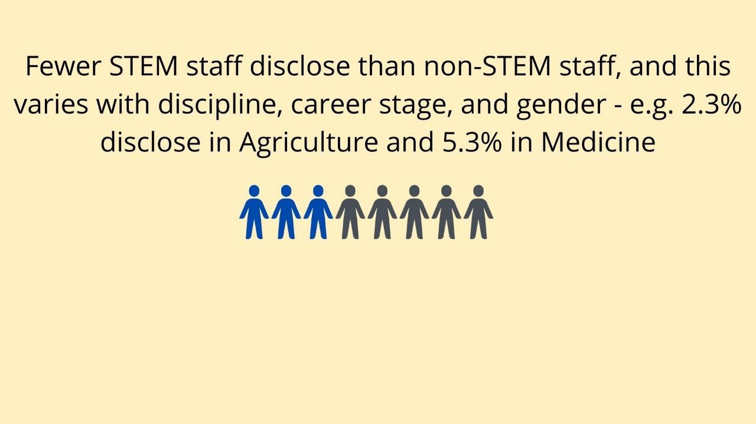
Disciplinary differences

Slide 13
Inaccessible Cultures
“I simply cannot work the long hours that I did before I was unwell. … This makes it extremely challenging to be as productive as I used to be. I am certain that this will affect my ability to publish and “keep up” with my contemporaries, and so I suspect that this will affect how I am compared to others when applying for a permanent academic role and grants.”
(Female, ECR, Chemistry, Physical disability or health condition) Qualitative research on barriers to progression of disabled scientists; Report for The Royal Society, 2020.
Staff report being stigmatised, challenged and questioned.
Some have been told not to pursue a career in academia as they would fail anyway in this environment.
“Ivory tower ableism is not accepting of illnesses, and there is a culture of not taking holidays or sick leave” PhD student
“I stayed at the same university because of support, but will there be consequences for that?” “yes” PDRA
“I would really struggle to stay studying in a lab now” Senior clinical scientist

Slide 14
The ideal academic
Doesn’t need to use the toilet
Changes topics easily
Works independently
Works 24/7
Is white
Does not need financial security
Can lift heavy equipment
Is mobile
Does excellent Research, Teaching, Impact, Engagement, Service
Doesn’t have a body
Networks
The Ideal Academic
Is a man
Attracts research funding
Has no caring responsibilities
Can think all the time
Likes to chat
Goes to conferences
Is a leader
Keeps quiet
Has endless energy
Hides any doubts
Can walk up steps
Has no dietary requirements
Doesn’t need quiet space
Sang, K (2017) “Disability and academic careers”

Slide 15
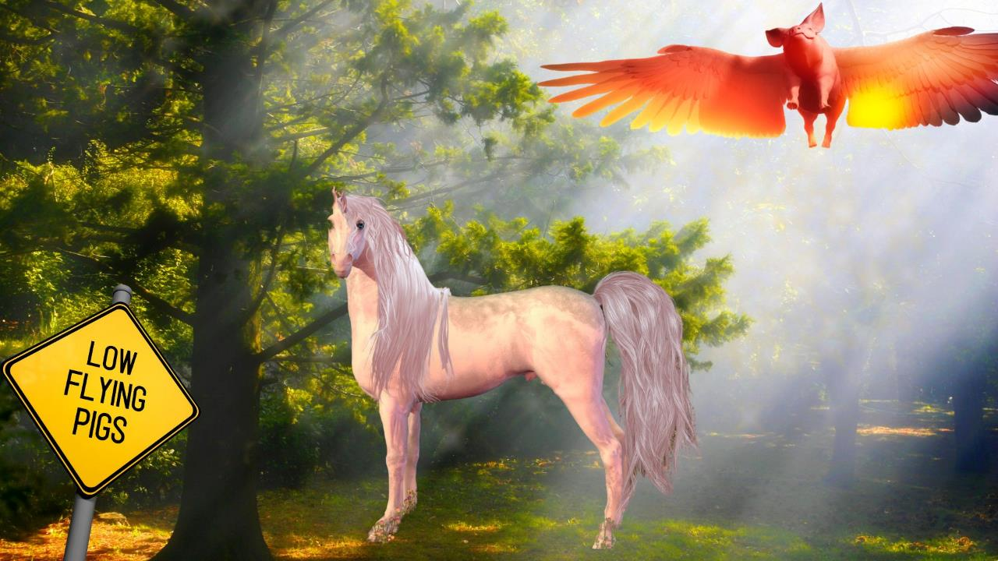
Probability of equity in research

Slide 16
So what can we do?
So what can we do?

Slide 17
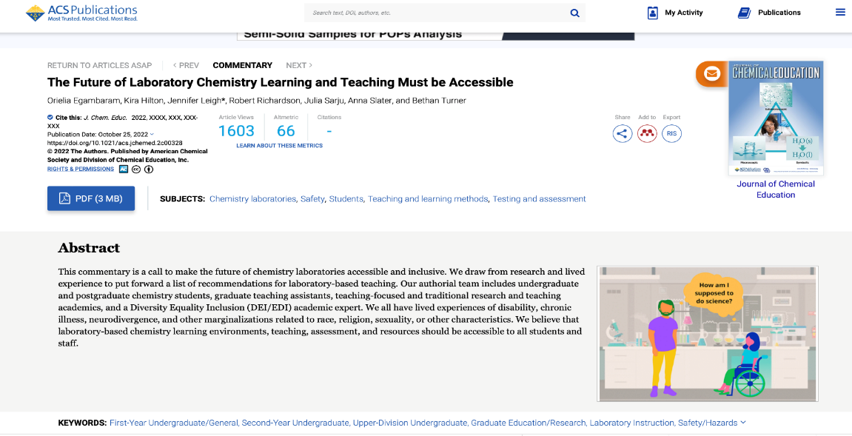
Make disability ordinary

Slide 18

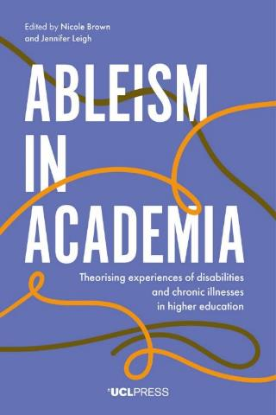
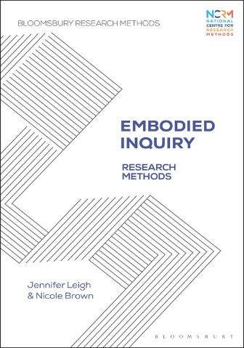
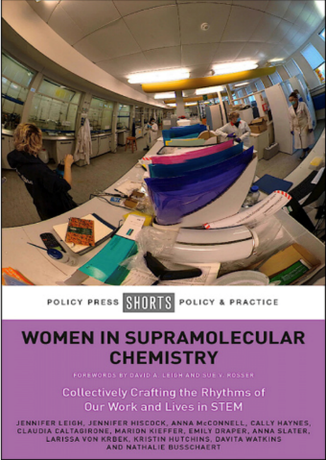
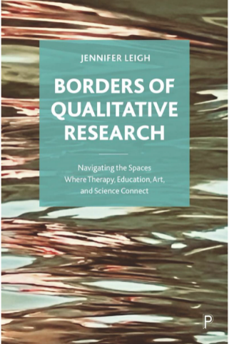
Use inclusive research approaches

Slide 19

Build networks and communities
Build networks and communities

Slide 20
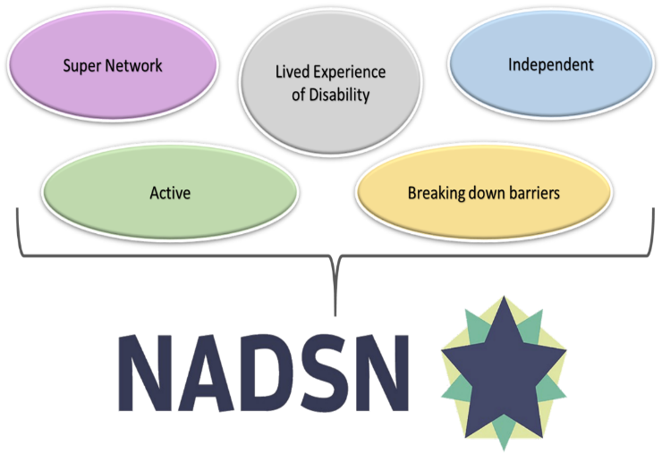
National Association of Disabled Staff Networks (NADSN)
Notes:
A super-network with a mission to connect and represent disabled staff networks at universities and colleges, and other interested organisations.
An unincorporated association, non-governmental, independent and self-determining, made up of impassioned disabled people.
A collective platform to share experiences and good practice and examine challenges and opportunities.
Partnering on active projects to break down barriers in STEMM and beyond.

Slide 21

WISC

Slide 22
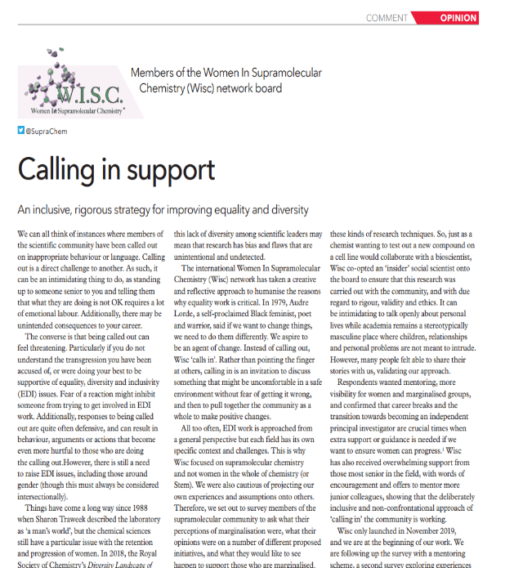
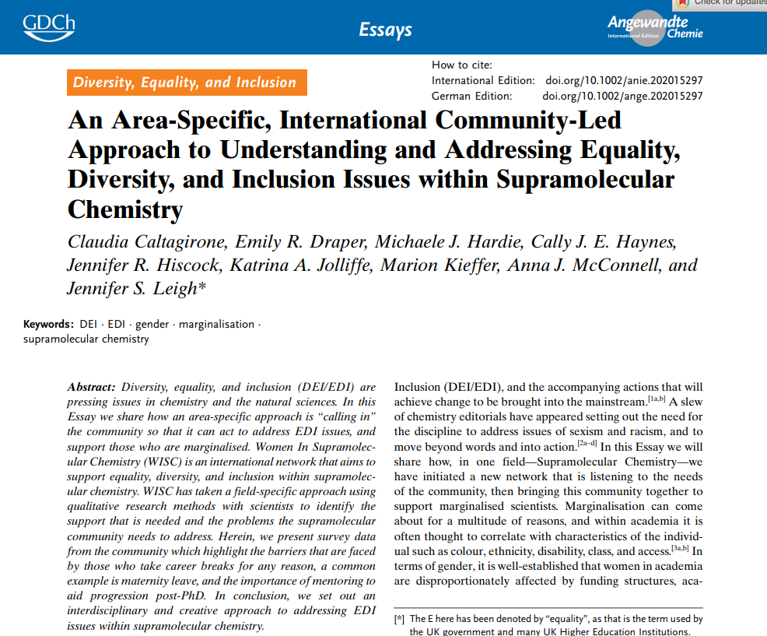
Research Publications

Slide 23
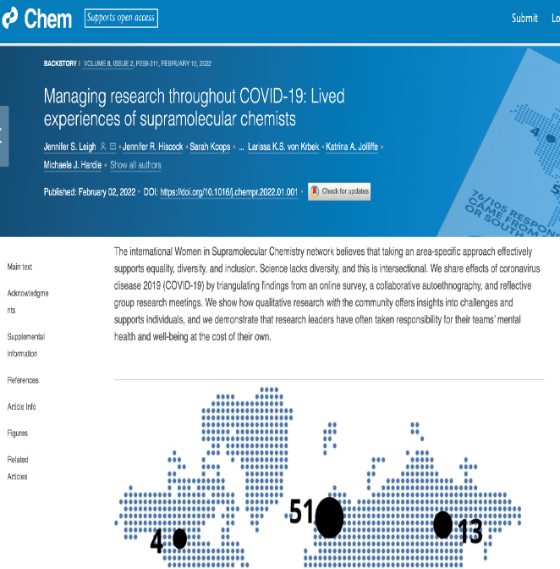
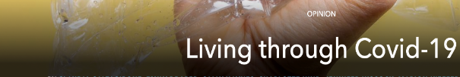
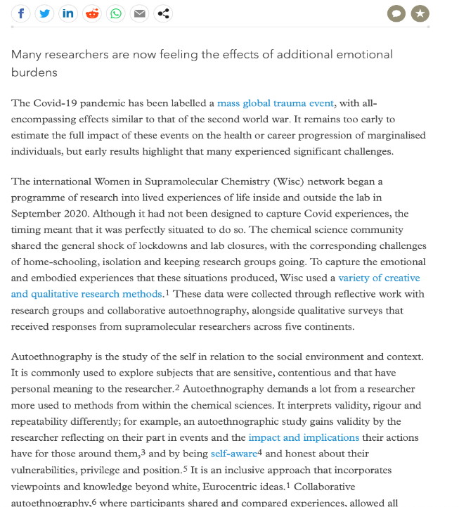
Research Publications Continued

Slide 24
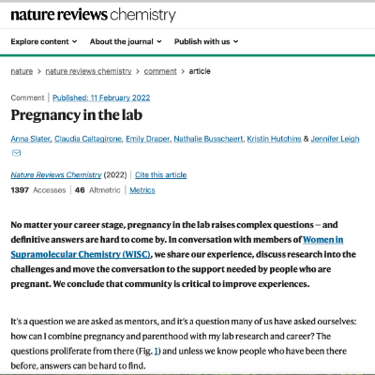
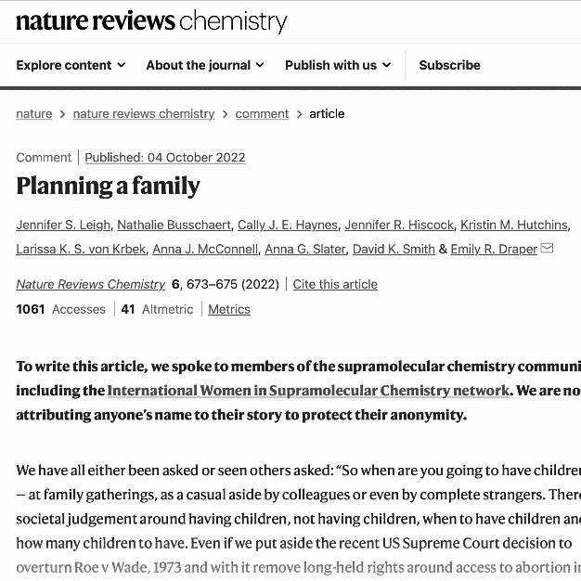
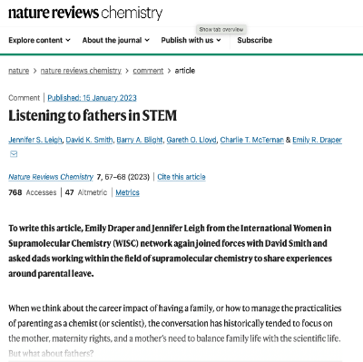
Comment Pieces on Family Life for
Nature Reviews Chemistry
Pregnancy in the Lab Planning a Family Listening to Fathers

Slide 25
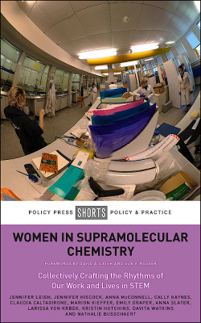
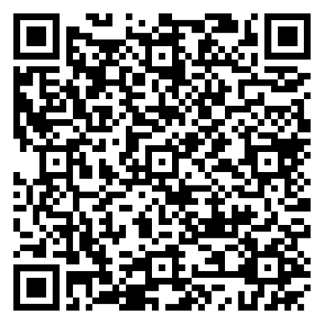
Women In Supramolecular Chemistry:
Collectively crafting the rhythms of our work and lives in STEM
(2022) Bristol: Policy Press.
Available Open Access from: https://policy.bristoluniversitypress.co.uk/women-in-supramolecular-chemistry

Slide 26
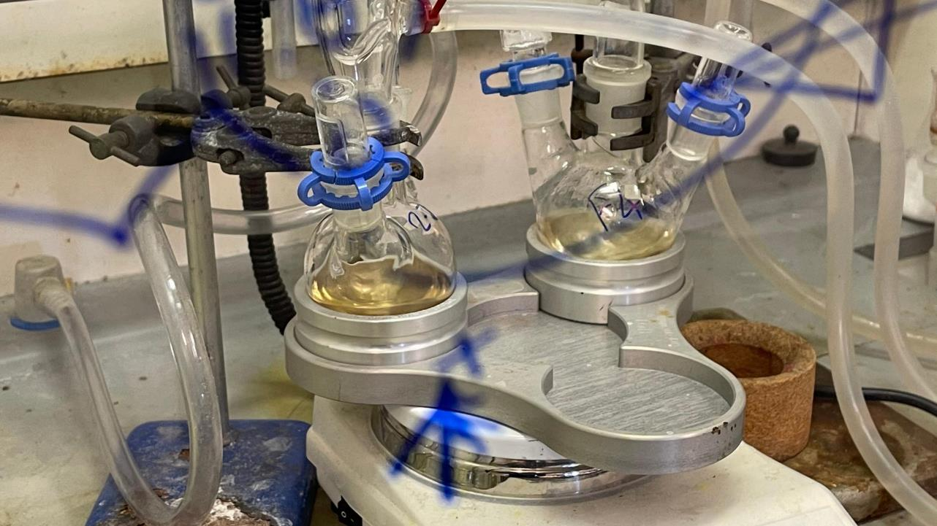
Inside a lab
Notes:
Paula, 33, Early Career
Until 2 months ago I was the only woman in my department. There doesn’t ever seem to have been more than one woman here at a time, I’m not entirely sure why. I’d like to think that it isn’t because they just want to have a ‘token’ but it does sometimes feel like that. You know, one woman, one person of colour. Actually, I wish there was one person of colour. It’s not great optics that our students are diverse but the faculty looks all white. I get asked to sit on a lot of committees. Hiring committees, ones where the department needs to be represented. I never like to say no because I know that the department will have to decide in the next couple of years whether they are going to make me permanent, and promote me. I need to have good relationships with them so that they ask me to collaborate on projects with them. If I say no then they might say that I haven’t given enough service to the department, or I haven’t been collegial enough and I might miss out on those opportunities. Now that I think about it there haven’t been that many opportunities coming my way from the department – most of the collaborative work I do has been as a result of my own networks outside the university.

Slide 27
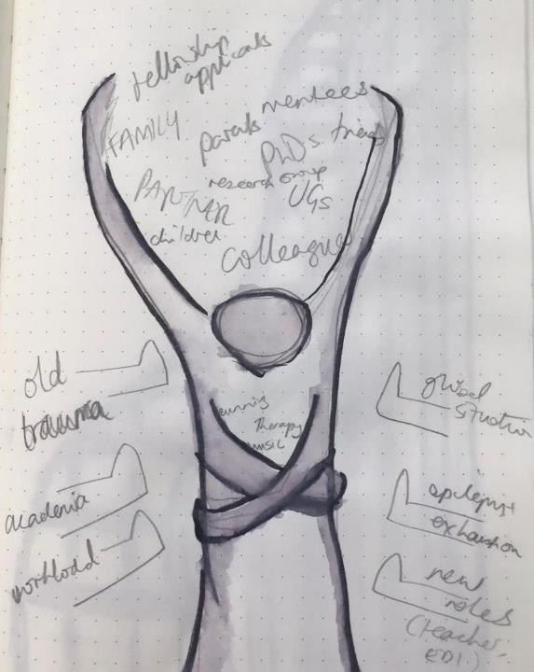
Carrying a load
Notes:
I do worry though that it all takes me away from my research. I don’t see work of this kind getting recognition when it comes to grant applications or promotion. It doesn’t seem to matter as much as papers and funding. Some of my friends told me that I should just say no more often, and put myself first. Instead, I have been getting up at 5 am just so that I have a couple of hours to write. I haven’t really published as much as I would like to yet, I’m only beginning in my career and developing my group. I don’t want to become known as ‘that woman’ if I keep banging on about it being unfair. I saw that happen to a friend when I was a PhD student. He was in a wheelchair and had to fight for everything. He wasn’t even lab-based so you’d think it would be easy enough to get a computer with the right keyboard, and for him to be able to get into the post-graduate office but still. He became a bit of an advocate for disability rights, and I think that is one reason why he couldn’t get a post-doc position. He left science in the end, I don’t know what he’s up to now.
I find that a lot of our women students want to work with me, or talk to me. They haven’t met many other women in the field, and they want my input or advice. They see me as a role model which is lovely, but it also takes away time from my own research…
Still, at least I haven’t experienced any direct discrimination! Some of the things I’ve heard, particularly at conferences! Conferences are good when there are other women about, it can feel a bit intimidating when you’re on your own. These days I have a little group of other women that I tend to stick with. Some of the things they’ve told me… Senior professors asking them what underwear they have on, being told that they shouldn’t be in the lab because their hands are too small to hold solvent bottles, or their wombs will sink because women aren’t meant to stand up at a fume hood! It didn’t seem to occur to that prof that women also have to stand up if they stay in the kitchen…I don’t think they are trying to be sexist, they just don’t realise that we face a barrage of little comments and innuendos all the time and it gets tiring.

Slide 28
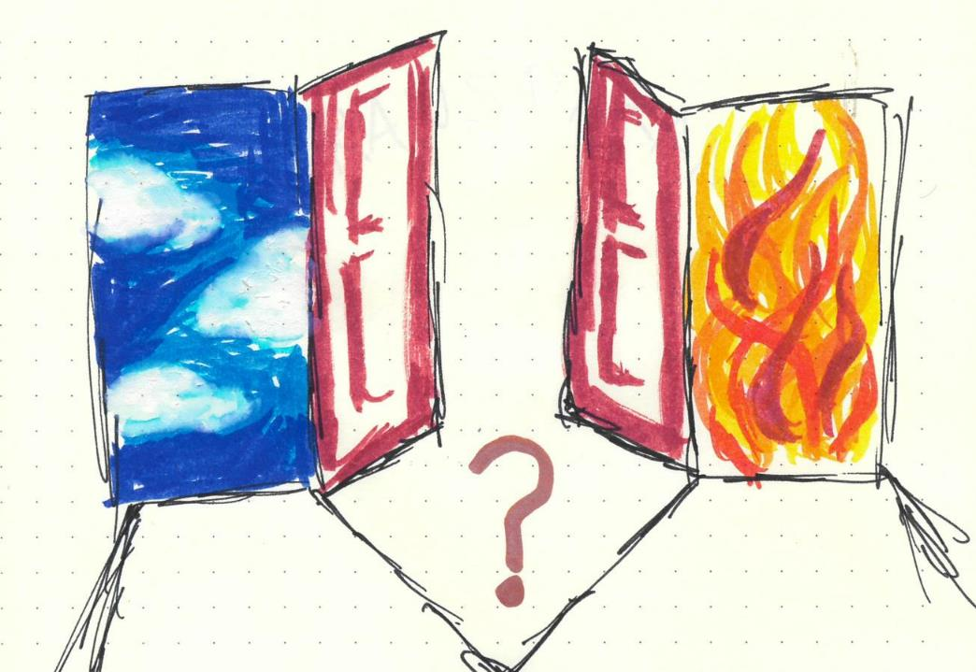
Which way?
Notes:
Adi, International PhD Student
I don’t think I want to stay in academia. I don’t know what I want to do yet, there’s a big part of me that wants to use my degree as I have worked so hard and spent so much time on it, but I don’t think academia is for me. For one thing I don’t see any faculty who look like me – there aren’t any Black women in my department. I look at my supervisor and see all the hours she works. Last year I know she was in the lab until 11 or 12 pm every night. She tells us that she has to work that much just to get things done. She’s not even a professor yet. There never seems to be any time to take stock of where we are and everything we’ve done – as soon as something works we just move on to the next thing. Before Covid we used to celebrate in the pub if the group published a paper, but these days it just doesn’t happen. It can’t happen. I don’t think it’s only my supervisor either. I remember how burnt out all my lecturers looked when I was an undergrad. Always rushing from one thing to another. It’s not that they didn’t help – they did or I wouldn’t be here now – but I don’t think it’s what I want for myself. Someone I know got a job as a lecturer straight after a post-doc. Almost unheard of right? But he has to do so much teaching and with everything online I can see that it’s almost breaking him. At least my group isn’t as bad as some. One friend I know is expected to work 11 hours a day six days a week and her supervisor regularly sets meetings at 8pm on a Friday night. I don’t think I could cope with that I want to have a life!
Even doing this is stressful. I cannot tell you the levels of stress that I just seem to cope with on a day-to-day basis and see as normal now! Worrying about not getting enough data, worrying when things don’t work, worrying that I am not living up to the huge sacrifices I made to come here. So much worry and fear. Leaving my family and boyfriend and only seeing them a few times a year is horrible. I worry that when

Slide 29
Thank you

