Slide 1
Dr Hamied Haroon
Disabled Lives Do Matter
Research Fellow in Quantitative Biomedical MR Imaging
hamied.haroon@manchester.ac.uk
@HHHotWheels

Slide 2
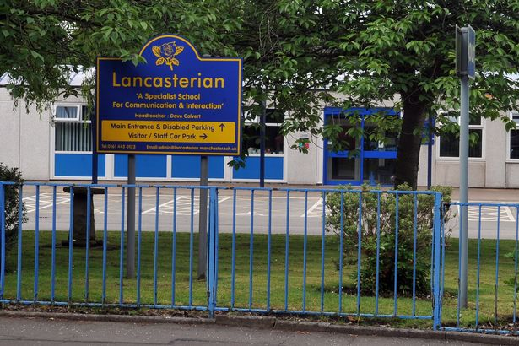
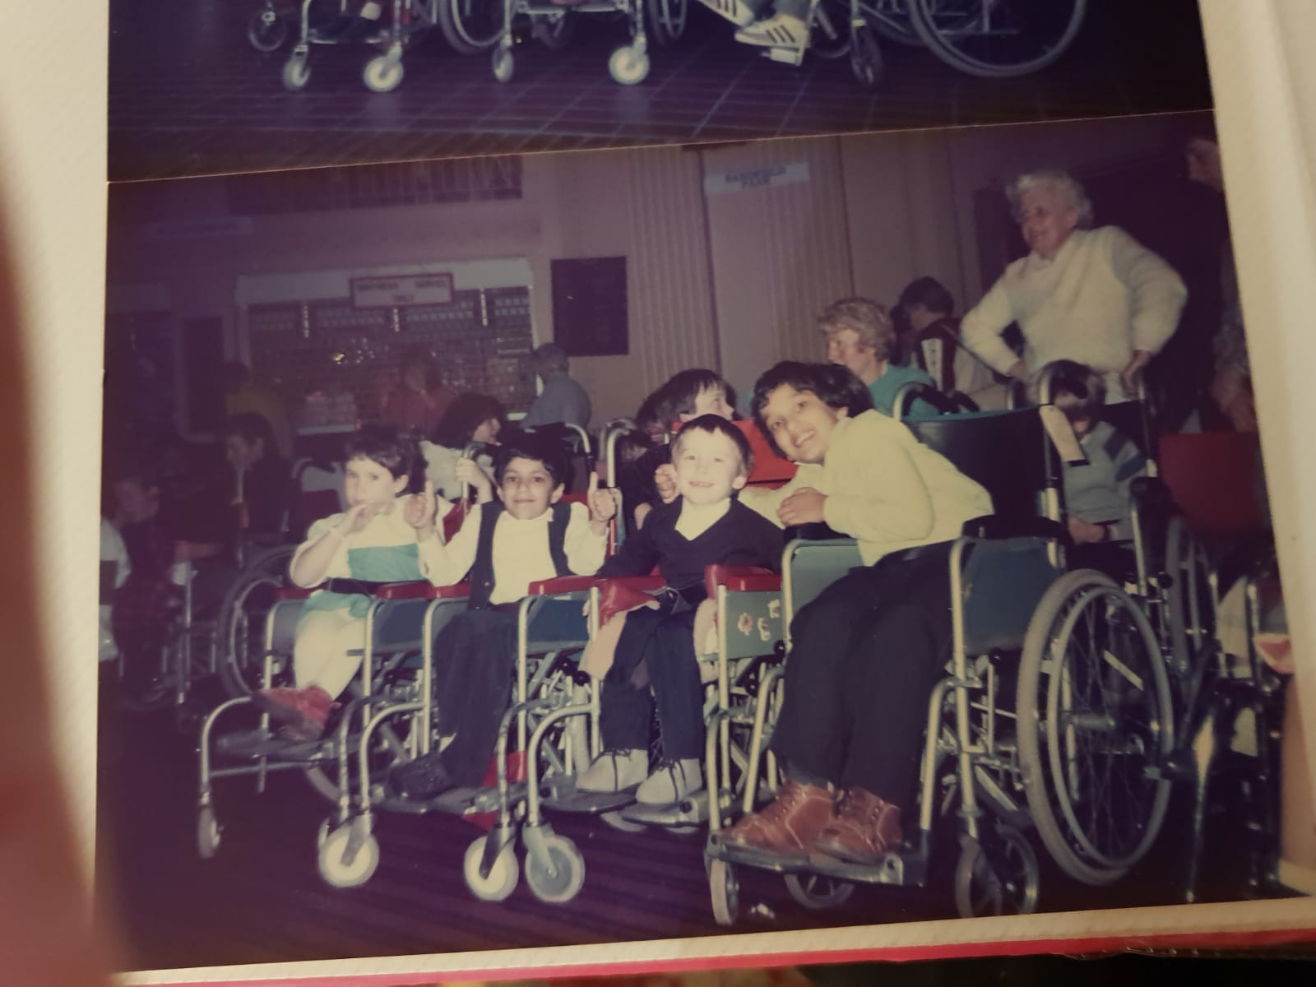
Notes:
My primary school years were spent at a special school in a leafy part of Manchester. The children there had a variety of disabilities, some with complex and severe impairments. I learnt some of my life’s most important lessons there about making the best of being disabled. We did lots of fun things like wheelchair dancing and taking part in fierce sports competitions against other special schools locally and nationally – winning plenty of trophies and medals – but the academic stimulation I needed wasn’t there.
I was really lucky. I was in the right place at the right time to be chosen as one of the first disabled pupils to attend the only accessible mainstream high school in Manchester at that time! This was my introduction to the real world. I absorbed everything high school had to offer. My favourite subject was science.

Slide 3
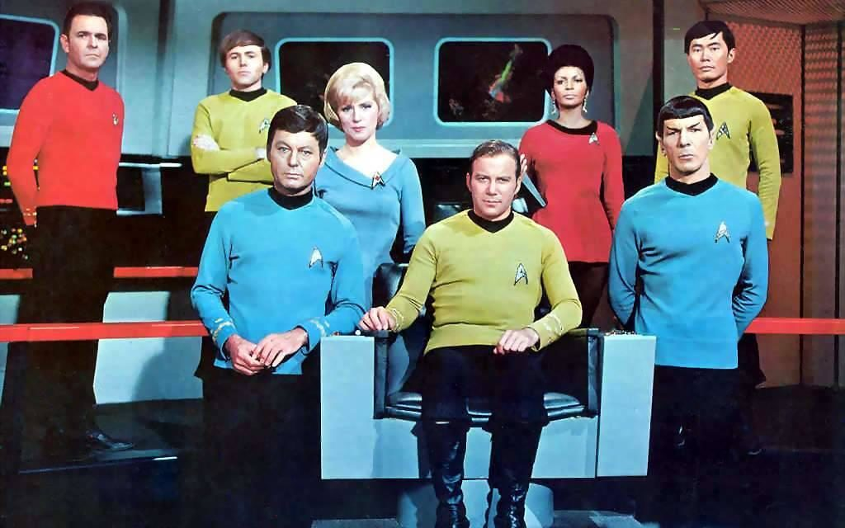
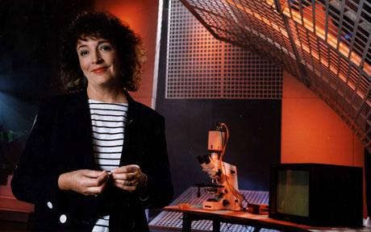
Notes:
TV programmes like Tomorrow’s World and Star Trek fuelled my passion for science. They were portals into the possibilities of the future, some of which have already come to pass. The way that Dr McCoy would wave a probe over an ill person, diagnose their illness and then cure them straightaway, without a hitch. That made me think, yes, I want to become a doctor.

Slide 4
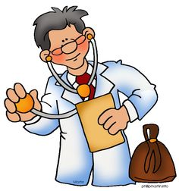
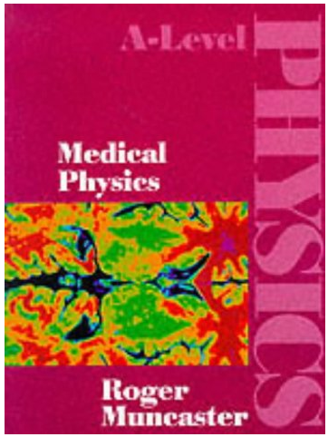
Notes:
Sadly, when the time came to seek careers advice, I was told that there was no way I could pursue medicine with my disabilities.
My mum said never mind you should become a lawyer instead. But I had my heart set on science! I achieved the best GCSE grades of my year and went on to study maths, physics and biology at A-level.
During a physics class I spotted a book on the teacher’s shelf that was entitled “Medical Physics”. This was like being struck by a divine bolt of lightning – I could enter the medical field as a physicist!

Slide 5
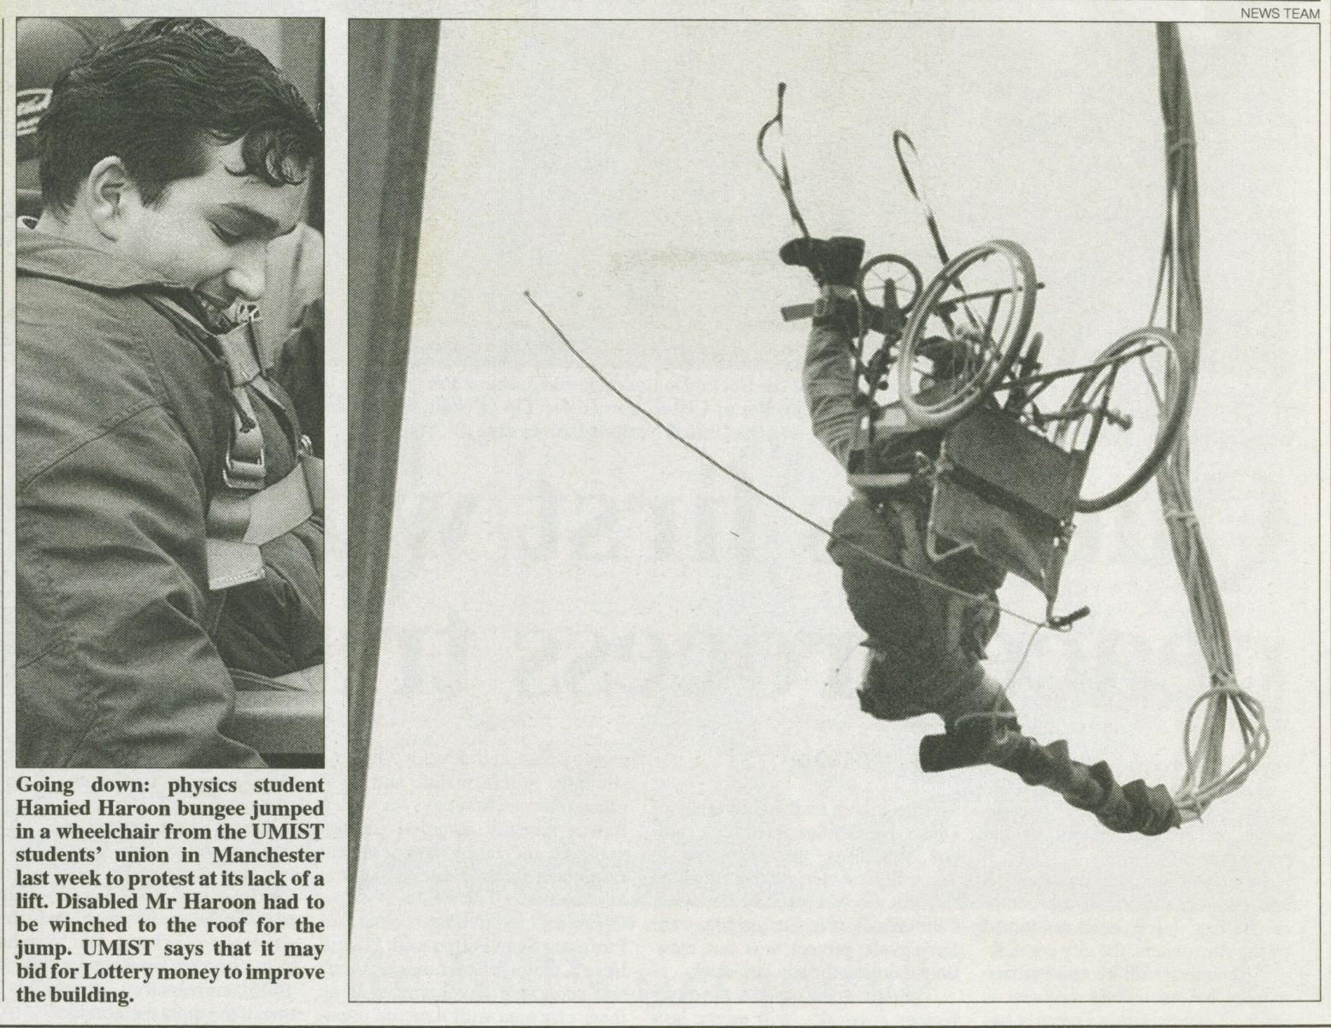
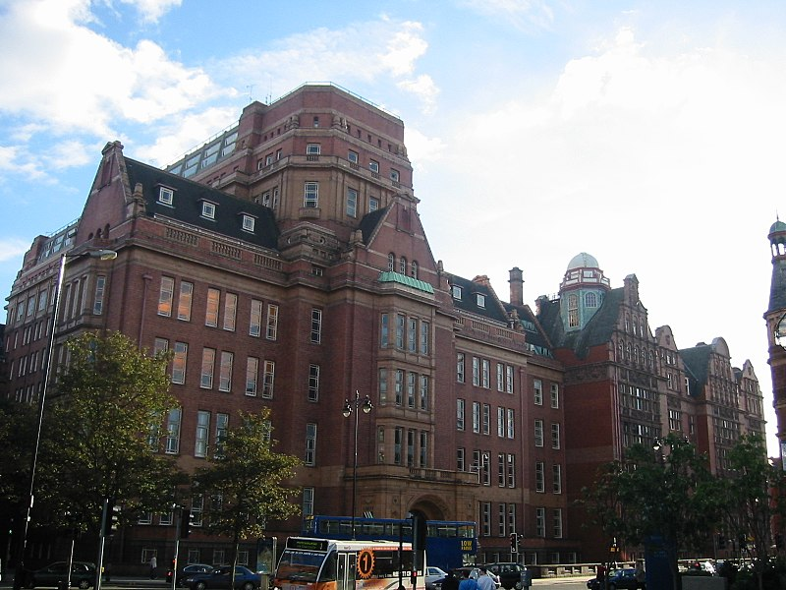
Times Higher Education - 8th December 1995
Notes:
While reading Physics at University I was elected to the Students’ Union as Disability Access Secretary and ended up doing a bungee jump in my wheelchair from a crane on the side of a main road in protest at the lack of access in some of the University’s buildings. This slide shows a snap of me upside down mid-bungee which featured in some major newspapers. This was the start of my brand of “disability activism”!

Slide 6
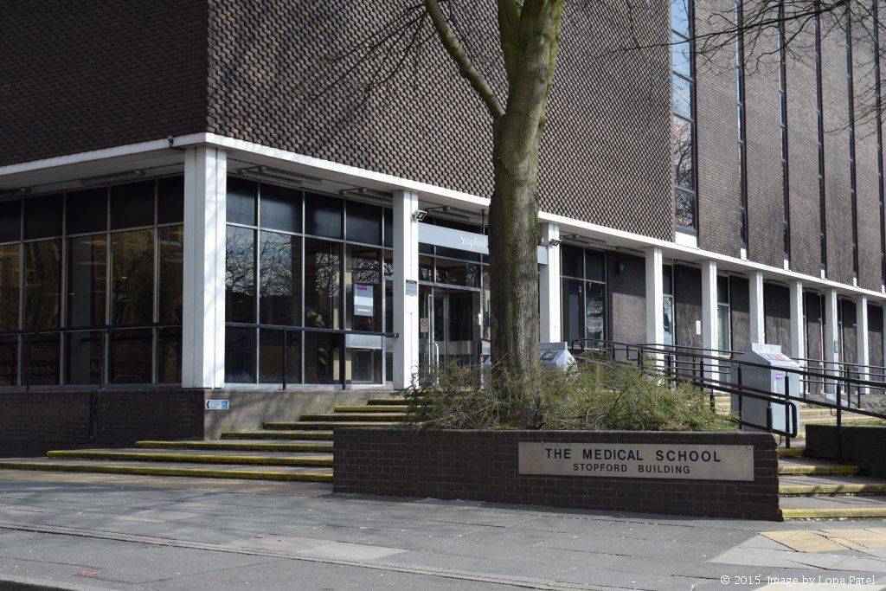
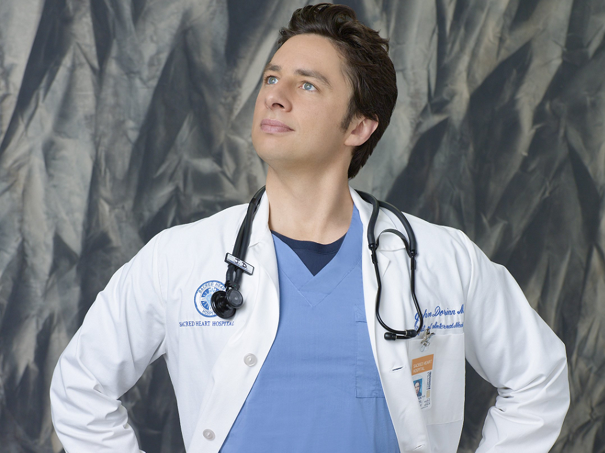
✓
✓
MSc in Medical Physics
PhD in Medical MR Imaging
Notes:
I wanted to do an MSc in Medical Physics after I graduated but I had no way to pay the fees. The Snowdon Trust came to my rescue at that point and again when this led on to a PhD. I am now an Ambassador for the Trust.
I started my PhD at the turn of the Century in developing novel analyses techniques of advanced magnetic resonance imaging in cancer.

Slide 7
Do I enjoy working as a Research Scientist?
YES!
Collaborating with all sorts of clever and inspirational people across the globe
Teaching and engaging with bright young people!
Being creative – facing new challenges everyday
Presenting at international scientific conferences
Notes:
Support is crucial. The integrated support I have is so important to me and lets me fulfil my potential, with independence and confidence. I need support. Without it I could not have studied or do my job. As a student I had the Disabled Students’ Allowance – which has sadly been restricted for future Hamieds! – and additional support from the Snowdon Trust. On becoming a member of staff, I suddenly lost that support. Thankfully my HR contact pointed me to a Government scheme he had heard of which supported disabled people in paid work called Access to Work! This scheme is still very poorly promoted – it’s like the Government don’t want disabled people to know about it! Access to Work allowed me to employ my personal assistant to help me with everyday physical tasks I couldn’t manage at work and to help me go to conferences – a vital part of being a researcher (even if the location isn’t so exotic). Without this support I would literally have to stay at home.
SKILLS, PERSPECTIVE what we bring!

Slide 8
We are a super-network with a mission to connect and represent Disabled staff networks
We focus on the tertiary education (universities and colleges) and public (NHS Trusts) sectors
We welcome any individual and organisation from any sector committed to promoting the equity, diversity, inclusion and access of Disabled staff
We act as a collective platform to share experiences and good practice and examine challenges and opportunities
We are a non-governmental, independent, self-determining and dynamic community, led by and made up of impassioned Disabled people
Visit us and join at:
nadsn-uk.org
@nadsn_uk
NatAssDSN

Slide 9
Our Aims – some of them!
Promote disability equality and campaign for disabled staff networks to be supported in the workplace
Promote the interests of disabled staff on a national level
Challenge stereotypes by endorsing the Social Model of Disability, promoting a positive image of disabled people and eliminating the deficit/medical model
Organise and deliver accessible events that can bring disabled staff and disability equality allies together
Create regional hubs to make it easier for members to meet each other
Support relevant research projects, policies and guidance for disabled staff, managers, institutions of tertiary education (HEIs and FEIs) and Government agencies
Link with disabled students, particularly at postgraduate and doctoral levels

Slide 10
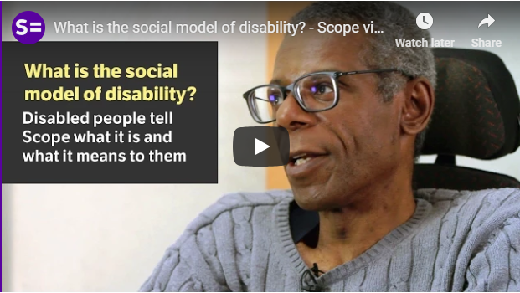
Social Model of Disability
“The social model of disability identifies systemic barriers, negative attitudes and exclusion by society (purposely or inadvertently) that mean society is the main contributory factor in disabling people” (Wikipedia)
Prejudice, ignorance, stigma
Negative attitudes
Inaccessible places, transport, conversations and information
Newer models: to include chronic illness and neurodiversity
Notes:
Covers learning disabled people, mental health, chronic illnesses, neurodiversity. Disability can affect anybody at any time of their life

Slide 11
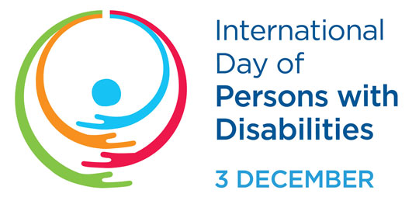
UN Convention on the Rights of Persons with Disabilities (CRPD)
Preamble of the CRPD:
“. . . disability is an evolving concept and that disability results from the interaction between persons with impairments and attitudinal and environmental barriers that hinders their full and effective participation in society on an equal basis with others.”
Notes:
Covers mental health, chronic illnesses, neurodiversity. Disability can affect anybody at any time of their life

Slide 12
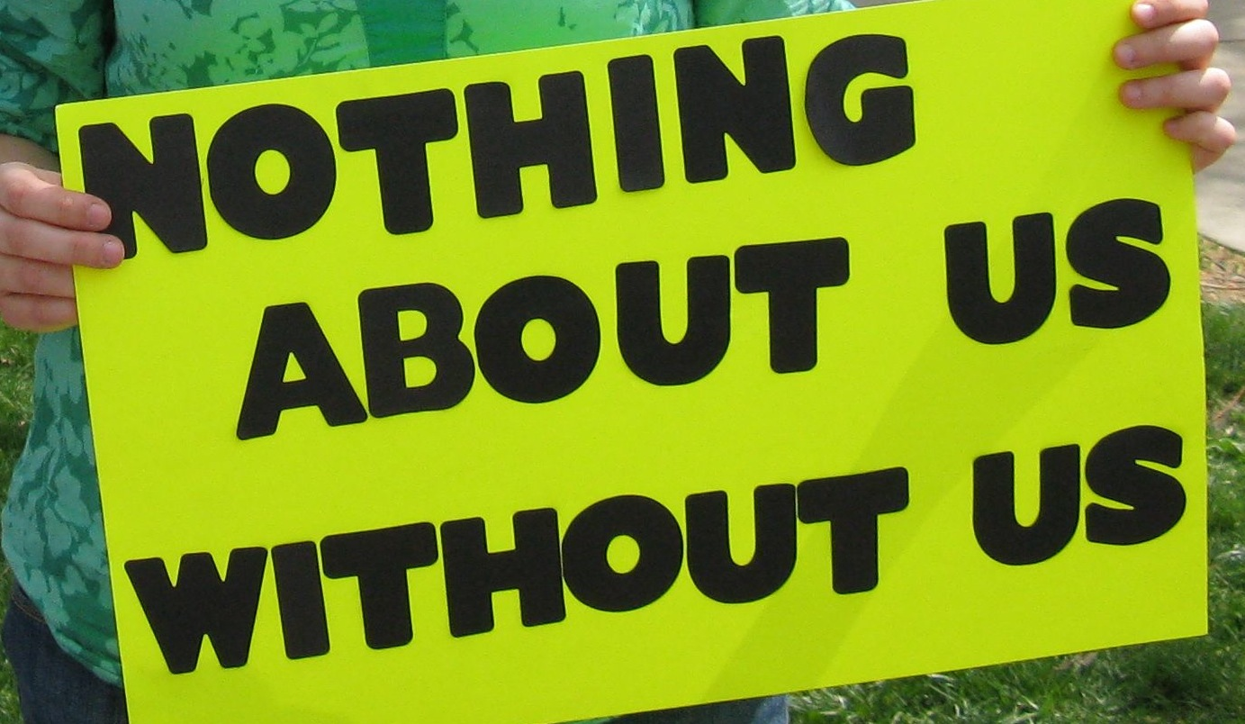
Notes:
Disabled people front and centre – lived experience

Slide 13
Doesn’t need to use the toilet
Changes topics easily
Works independently
Works 24/7
Is white
Does not need financial security
Can lift heavy equipment
Is mobile
Does excellent Research, Teaching, Impact, Engagement, Service
Doesn’t have a body
Networks
The Ideal Academic
Is a man
Attracts research funding
Has no caring responsibilities
Can think all the time
Likes to chat
Goes to conferences
Is a leader
Keeps quiet
Has endless energy
Hides any doubts
Can walk up steps
Has no dietary requirements
Doesn’t need quiet space
Sang, K (2017) “Disability and academic careers”

Slide 14
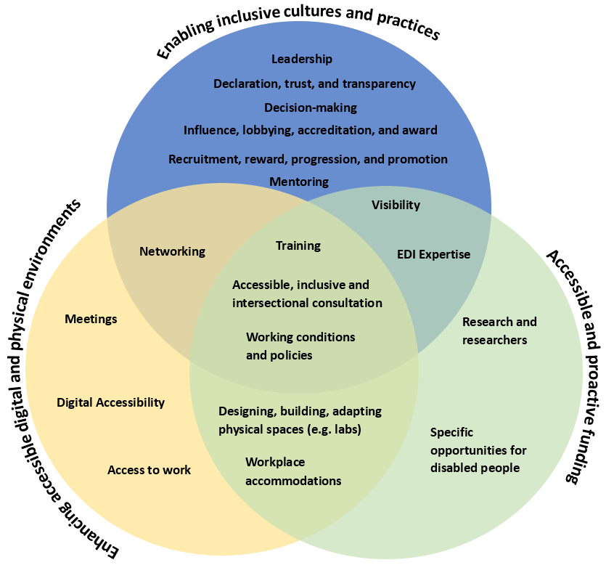
Disability (Ex)Inclusion in STEMM
A Recommendations Project led by
NADSN STEMM Action Group
https://t.co/ugFHhBXPd3
Notes:
We have gone on to form the NADSN STEMM Action Group. We are currently working on a recommendations paper for “Disability Inclusion in STEMM”, where we have identified actions under three main themes that also intersect …

Slide 15
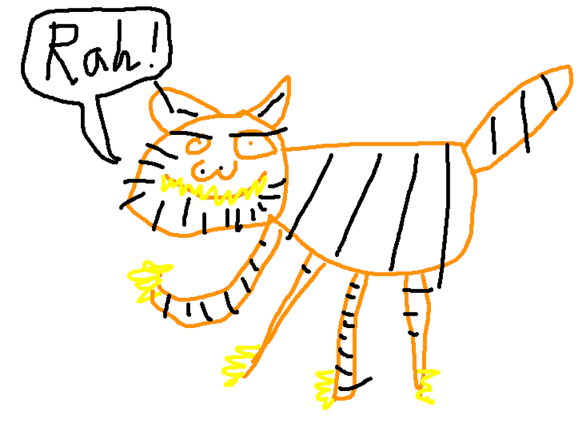

Slide 16
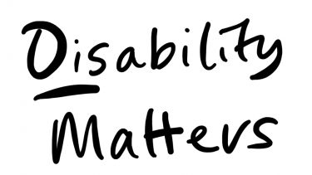
Disability as driving subject of inquiry
Professor Dan Goodley, et al
https://www.sheffield.ac.uk/ihuman/disability-matters

Slide 17
The research questions
How is health research, theory and scholarship transformed by an engagement with critical disability studies?
What are the health priorities of disabled people in Australia, Canada, India, Singapore and the United Kingdom?
What kinds of research methodologies represent disabled people and their health priorities?
How does the presence of disability enable more inclusive health research environments?
In what ways can we reimagine representations of disability in health research?
How do we build a new generation of disabled and disability-positive health researchers?
What transformative knowledge pertaining to equity, diversity and inclusion can be generated through a focus on anti-ableist and anti-disablist practice?

